Slide 1

Sketching, Low-fi Prototyping & Pilot Usability Testing
Assignment 5

Slide 2
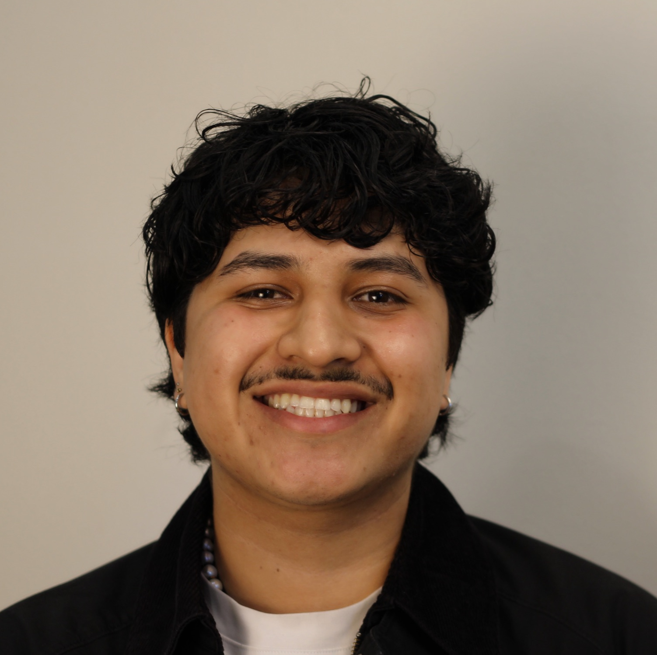


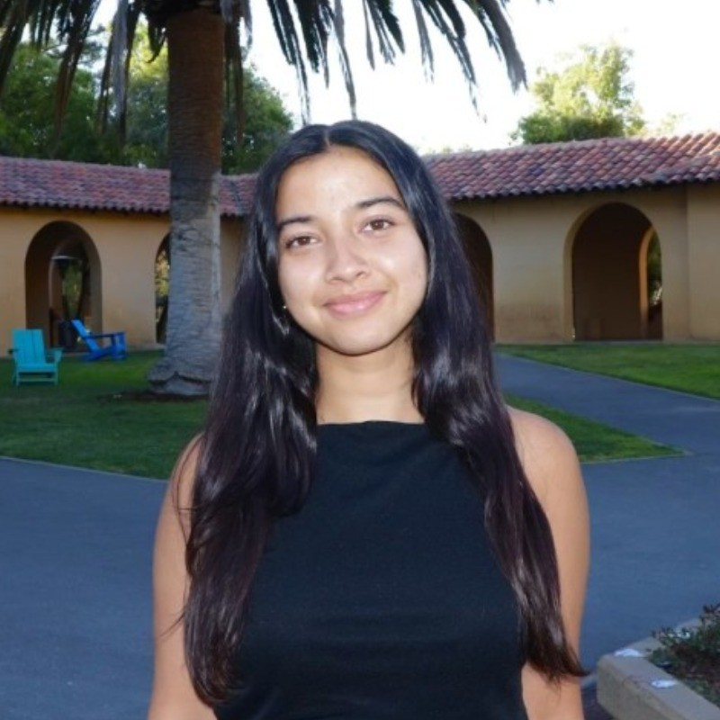
TEAM BAGG
Gil S.
Bennie N.
Gabriella U.
Amesha B.

Slide 3
OUTLINE
1
Review Kyro
4
Testing
2
Concept Sketches
5
Results & Discussion
3
Lo-Fi Prototype

Slide 4

PROBLEM + SOLUTION
People overcommit and lose track of their own energy without understanding the cause, leading to burnout, confusion, and poor emotional balance.
Kyro helps users visualize, protect, and plan around their personal energy, not just time, to build healthier days and burn out less often.
Primary Users: Adults between 25-44
highest users of scheduling tools
Age group currently most susceptible to burnout

Slide 5

Value Proposition
SMART SCHEDULING POWERED BY HOW YOU FEEL

Slide 6
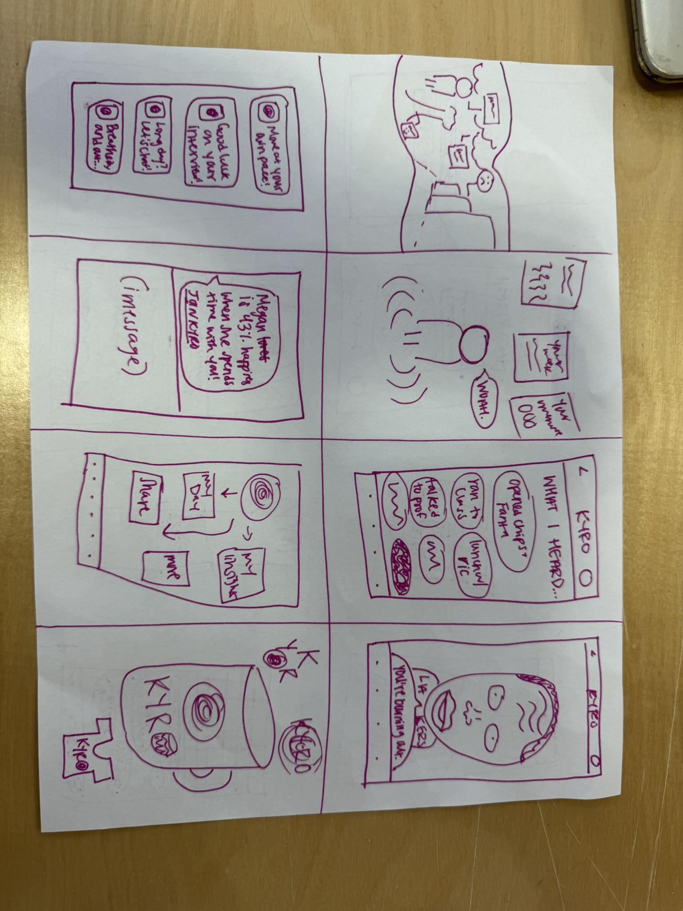
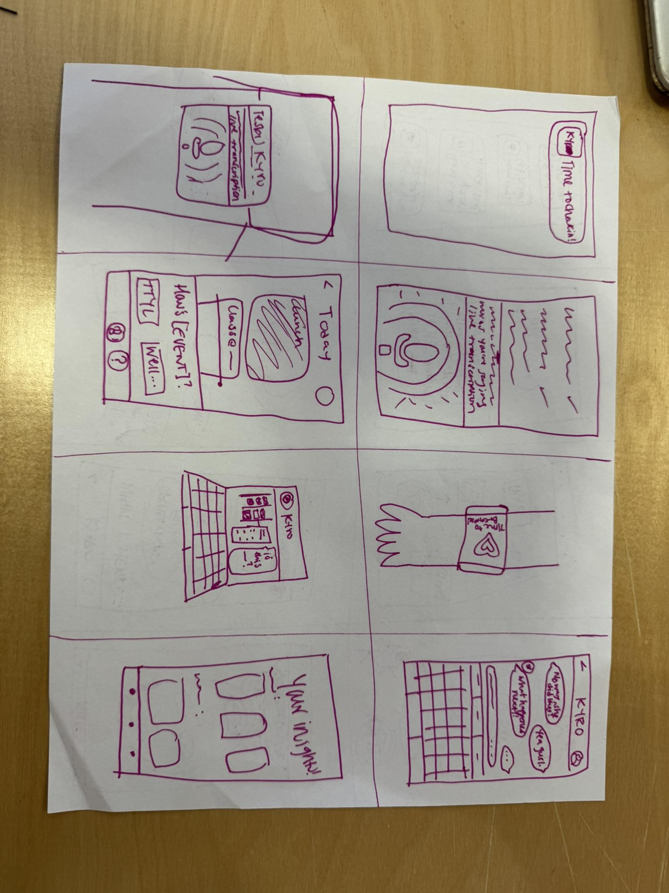
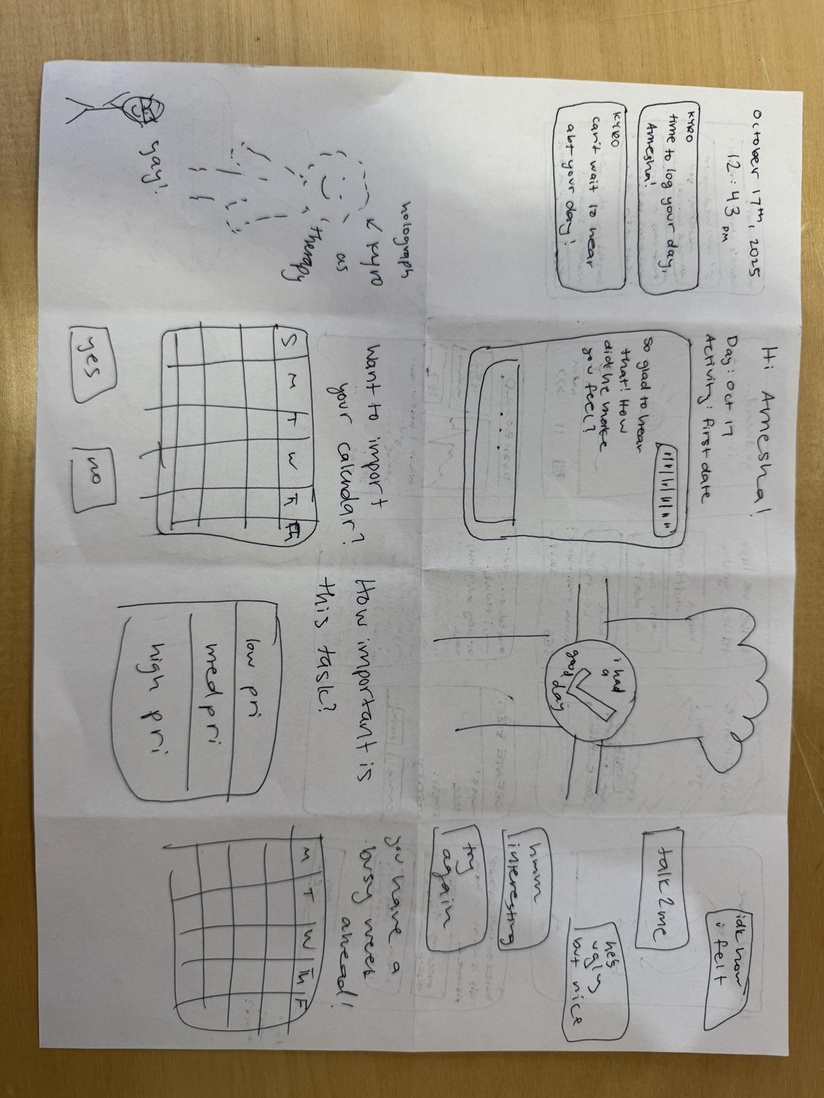
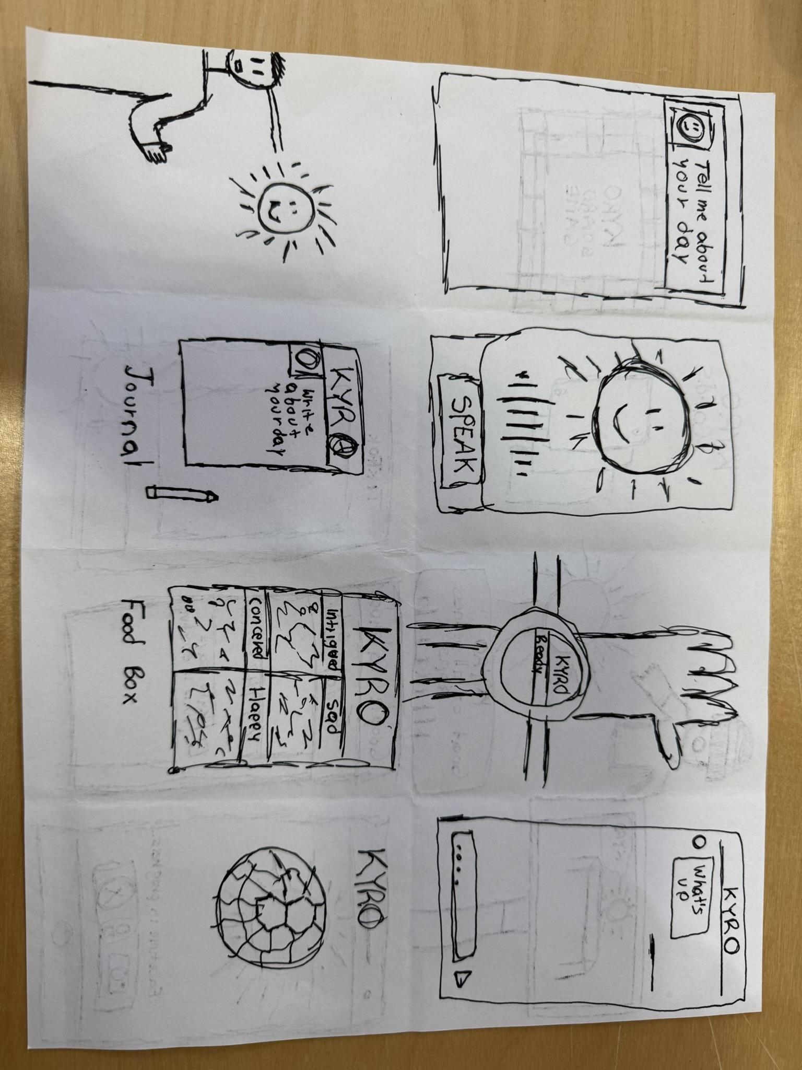
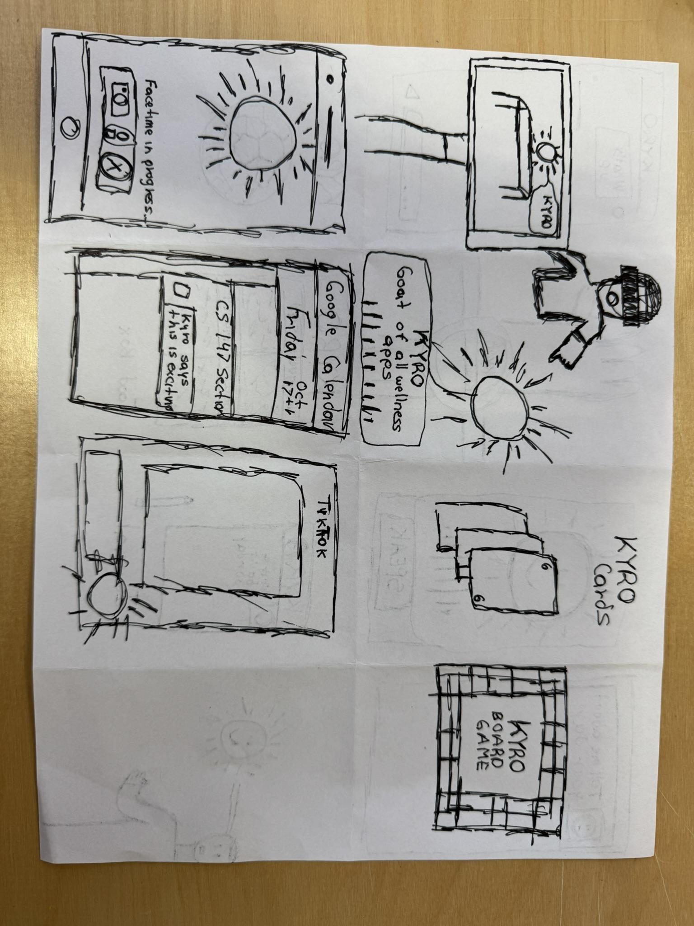
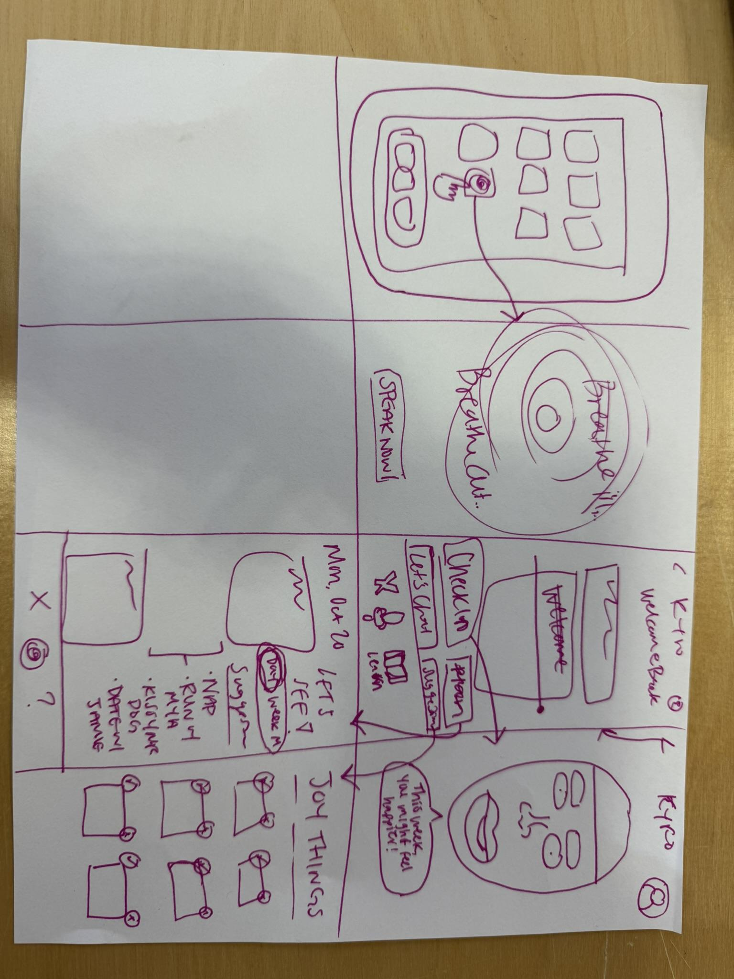
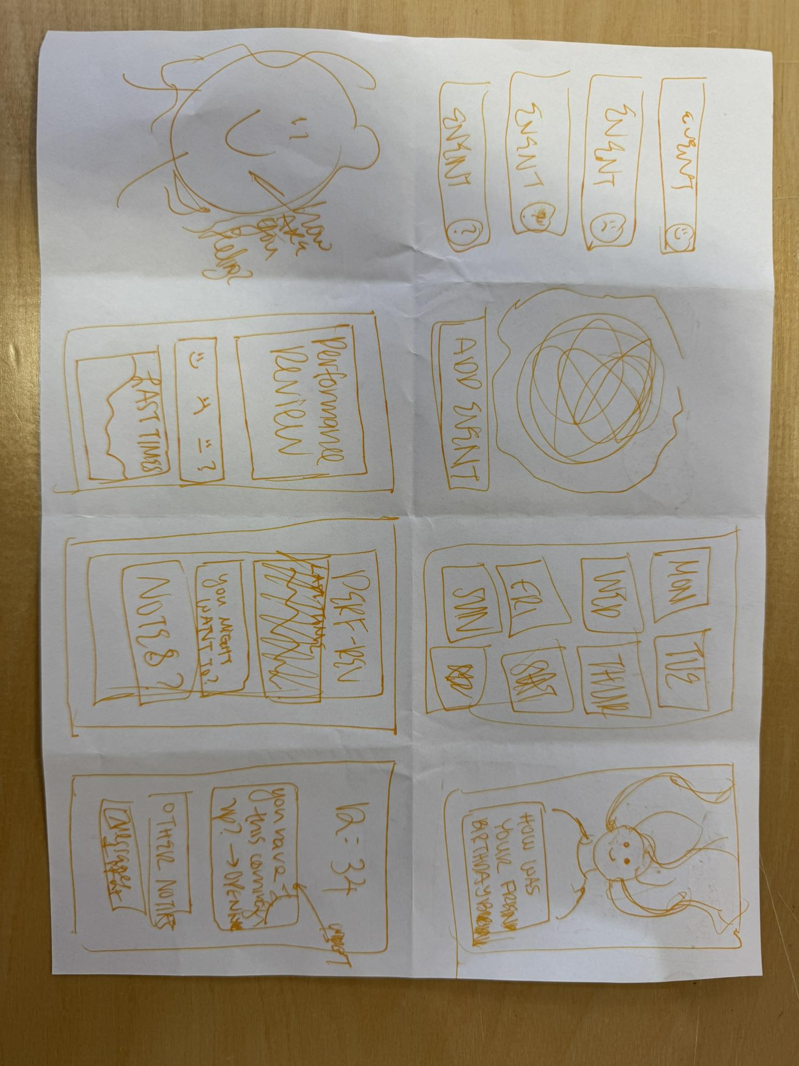
INITIAL
SOLUTION
IDEAS

Slide 7

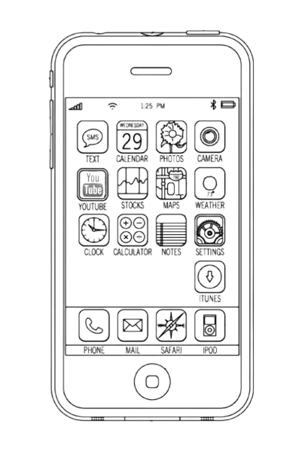
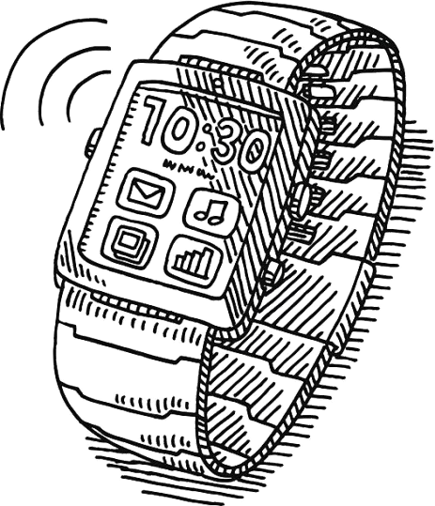
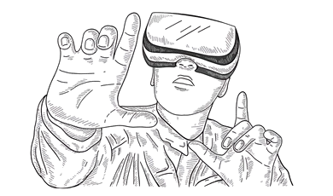
AR GLASSES
VIRTUAL REALITY
MOBILE
SMARTWATCH
Our 4 Distinct Modalities
(Chosen from 20–30 initial sketches)
Exploring each modality through low-fi sketches

Slide 8
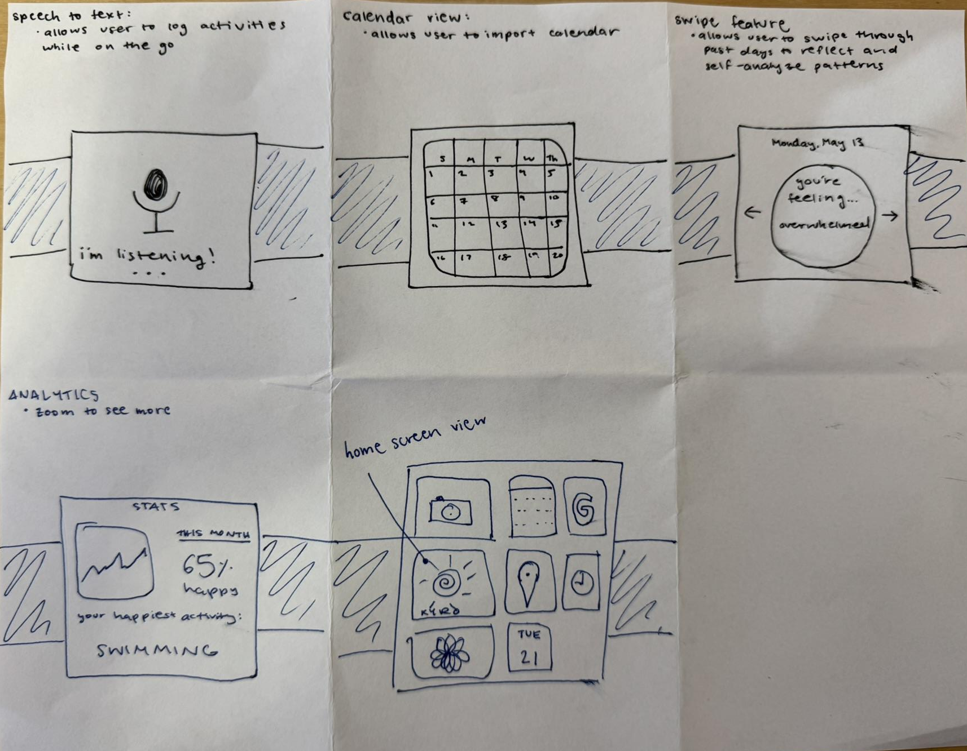
SMARTWATCH
Quick emotional reflections on the go
Prototype concept 1 of 4

Slide 9
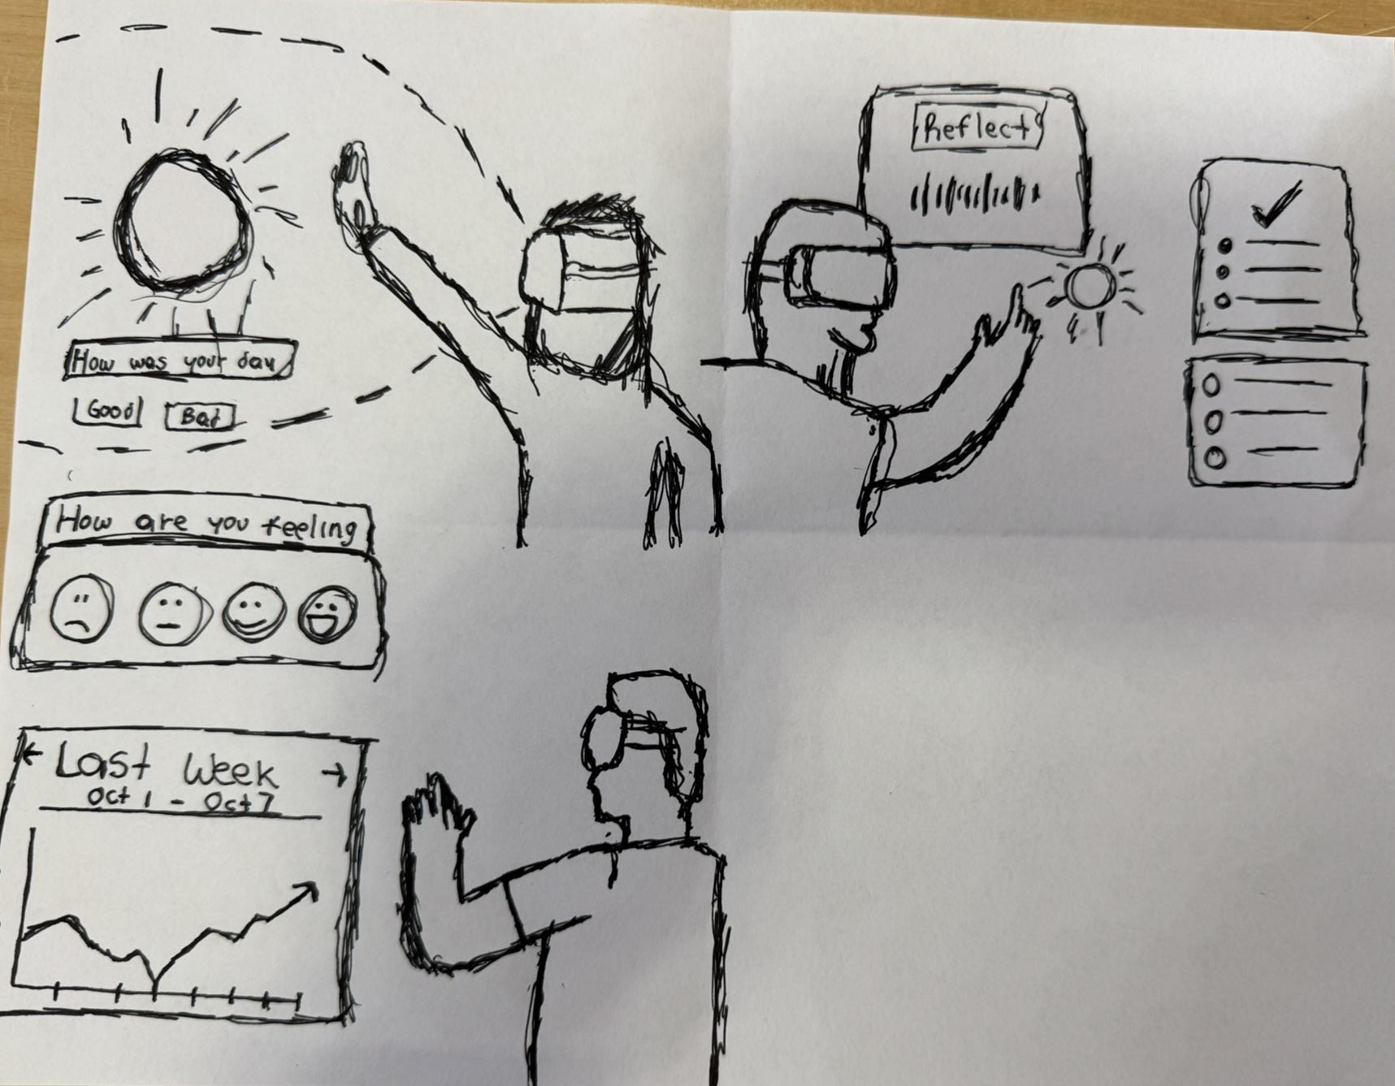
VIRTUAL REALITY
User has the ability to interact with multiple features at the same time such as reflecting with voice and generating ToDos out of it
Opening Page: Immediate check in about user’s day as they first open Kyro
ToDo List
Immersive self-reflection through environment and gesture
No need of a joysckick to use Kyro*
User’s right side perspective*
Analytics
User has the ability to track and see current and past emotions
Prototype concept 2 of 4
User’s left side perspective*

Slide 10
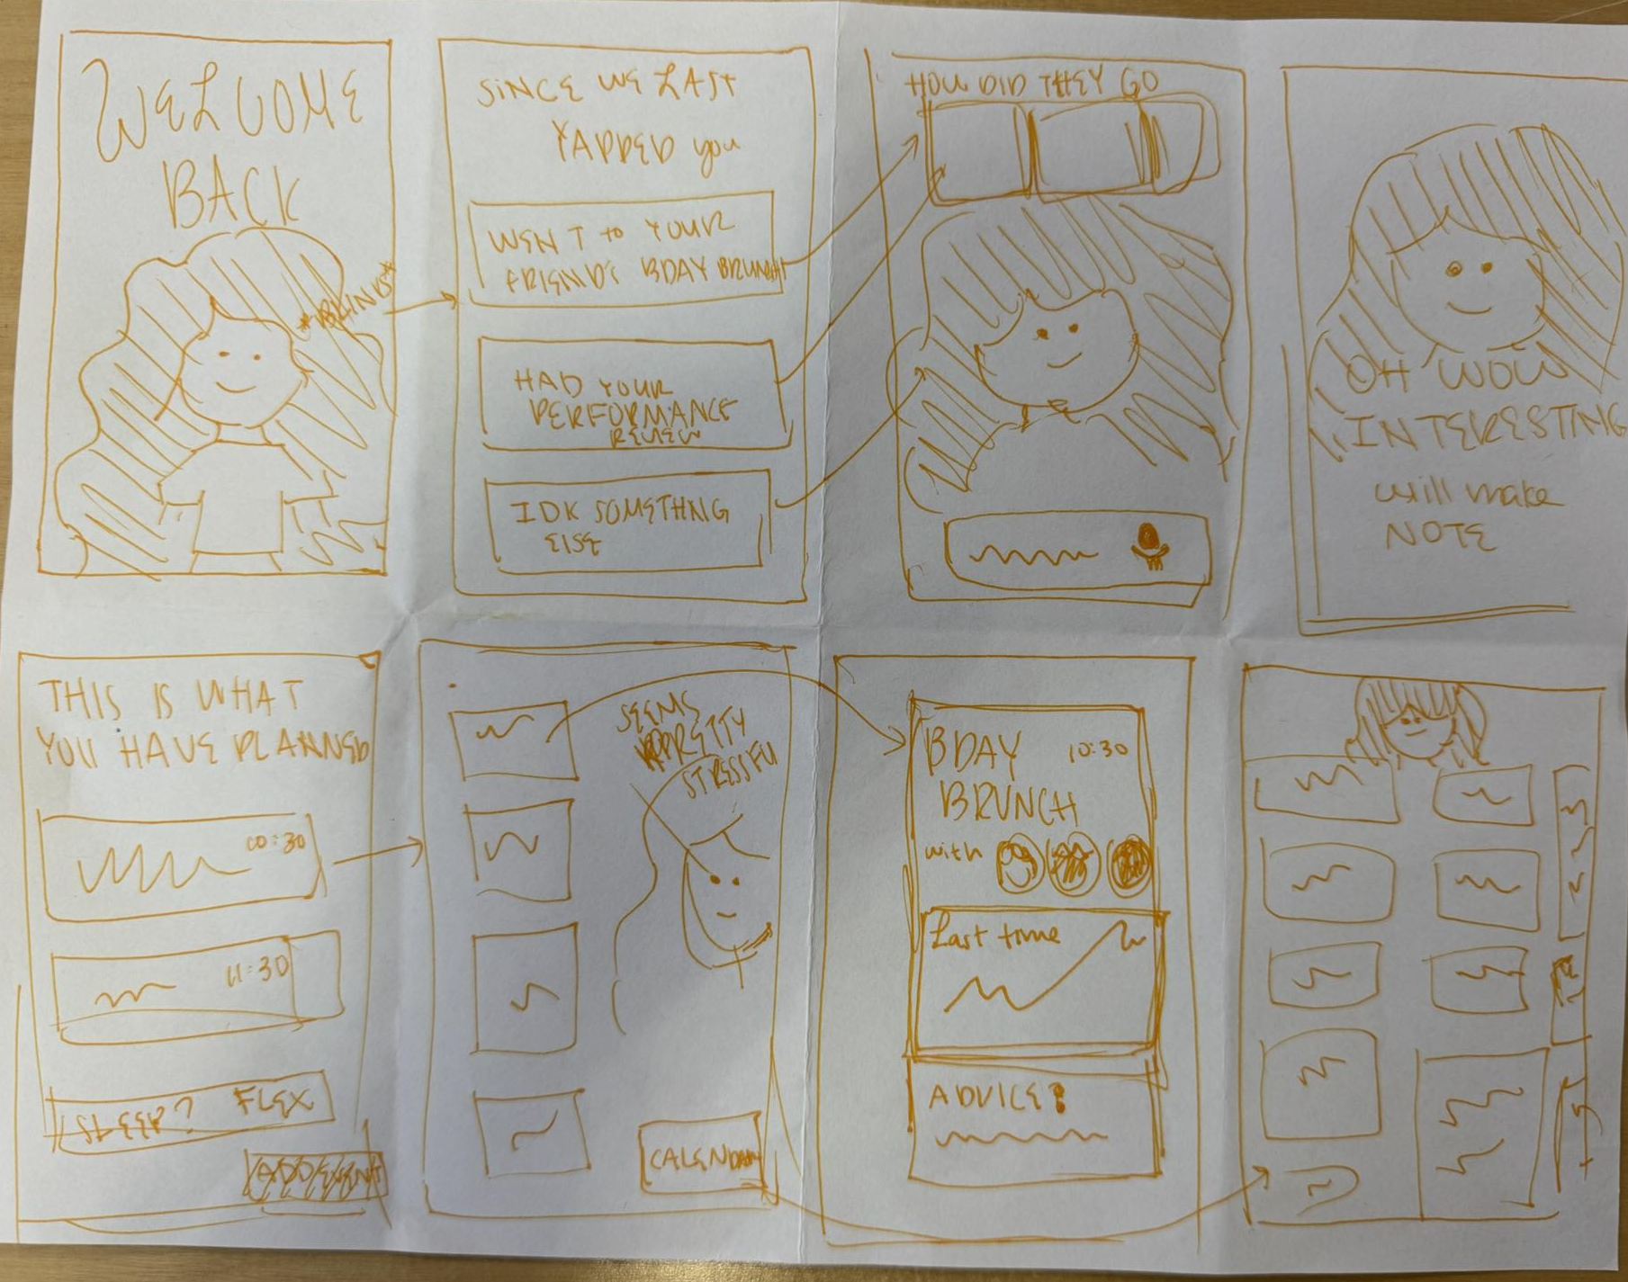
MOBILE
The app provides a summary of previous events based on already contained event data
Everyday emotional scheduling and insights
The small summaries of events moves above as prompts for the reflection on previous tasks
An anthropomorphized character welcomes the user upon landing.
As summary loads, image is provided affirming that information was recorded
Summarized upcoming events and provides suggestions of what you could do
Upcoming event elements are clickable to give emotional advice about how you might feel going into them
an upcoming event with predictive elements about emotional impact
a more full view calendar.
Prototype concept 3 of 4

Slide 11
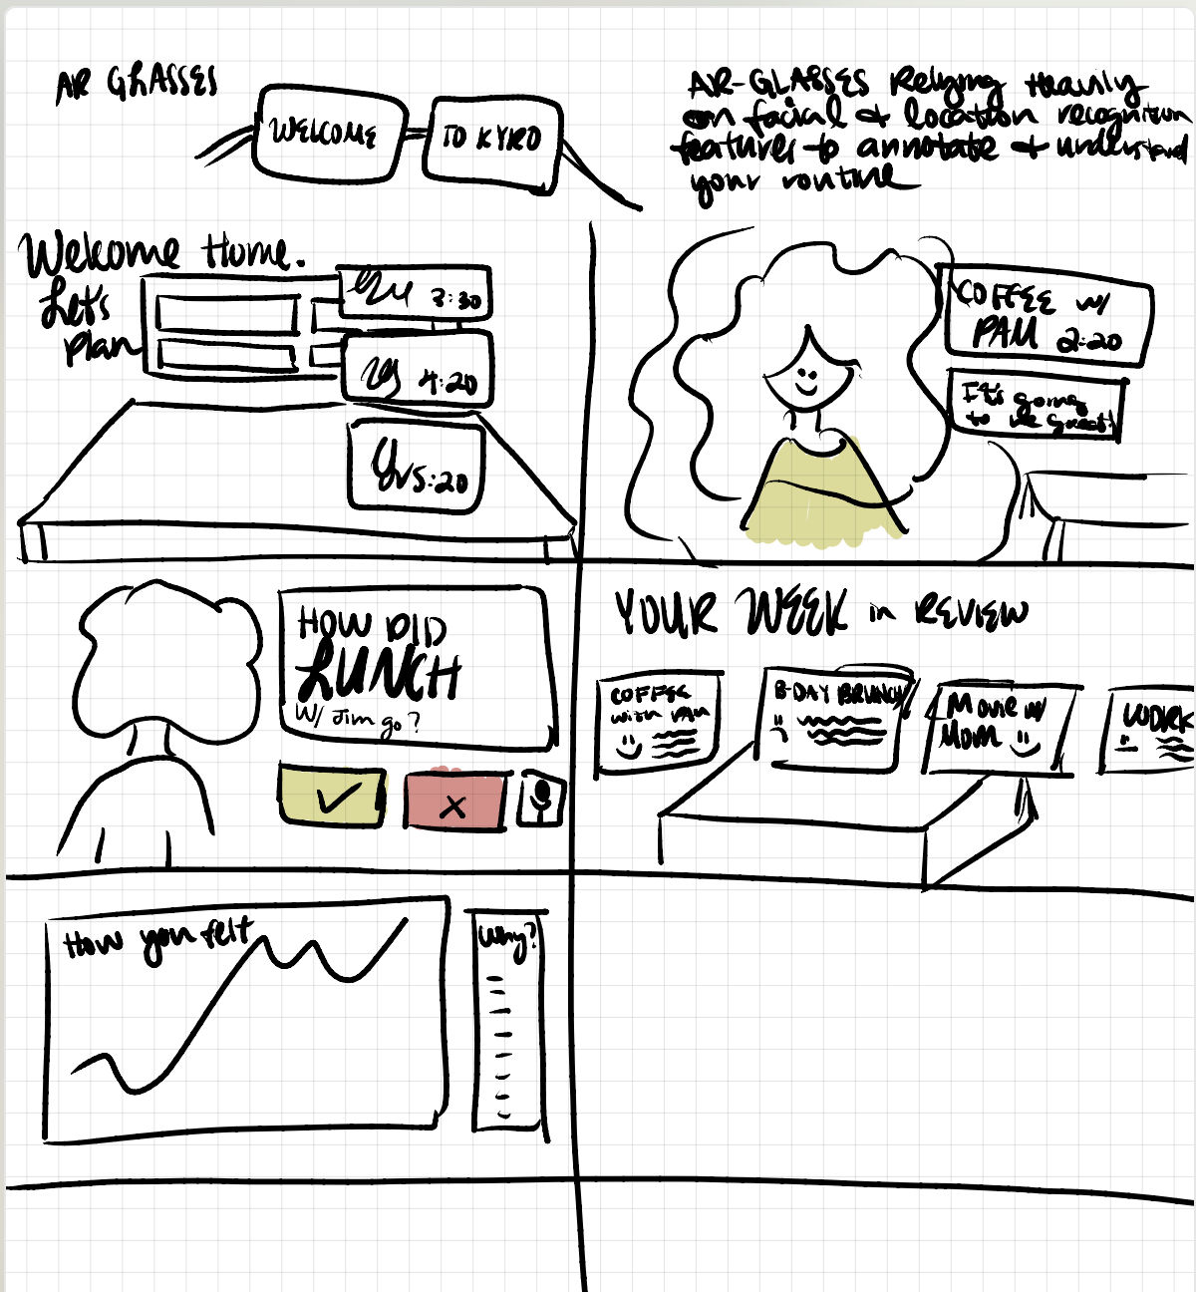
AR GLASSES
Location & Time based Augmented Reality
Prototype concept 4 of 4

Slide 12
SMARTWATCH
MOBILE
Refining Our Top 2 Modalities
Focusing on two distinct user contexts
Sketching key user flows for deeper exploration

Slide 13
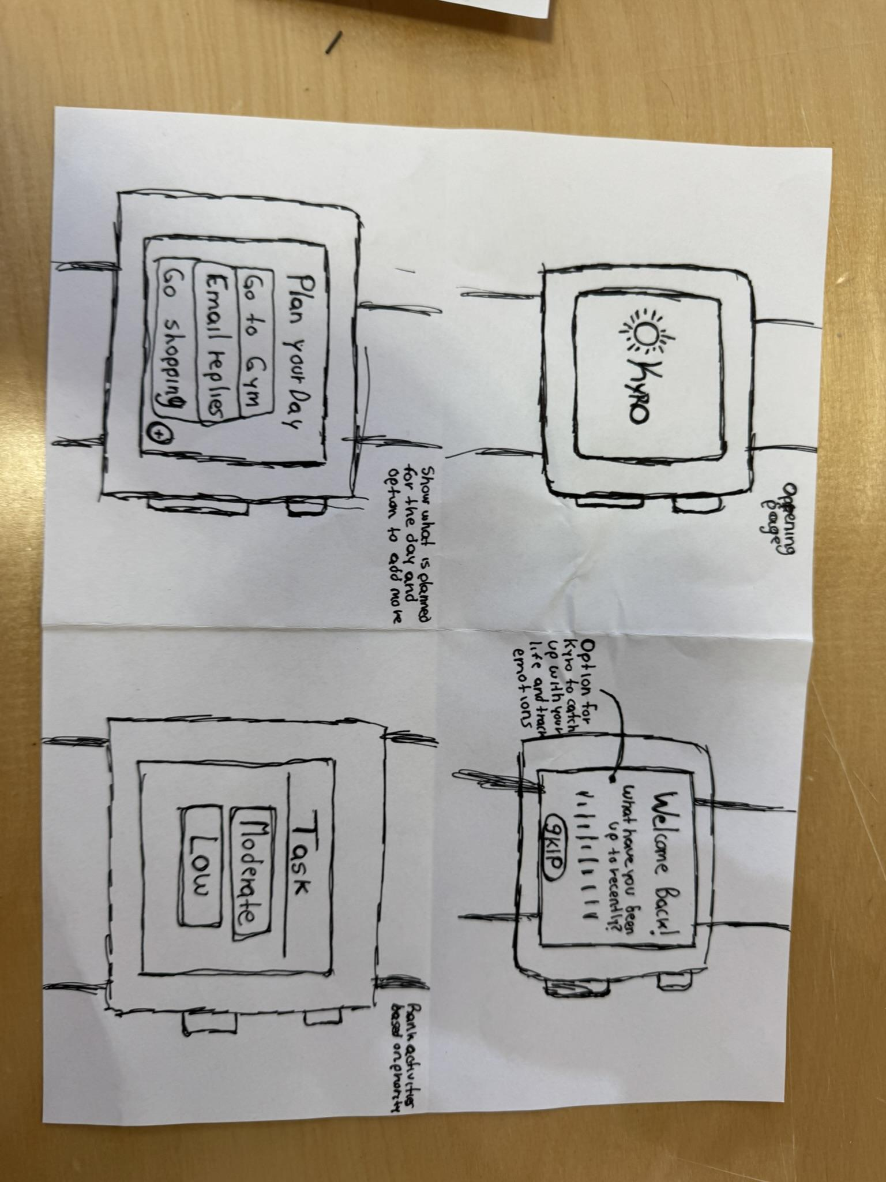
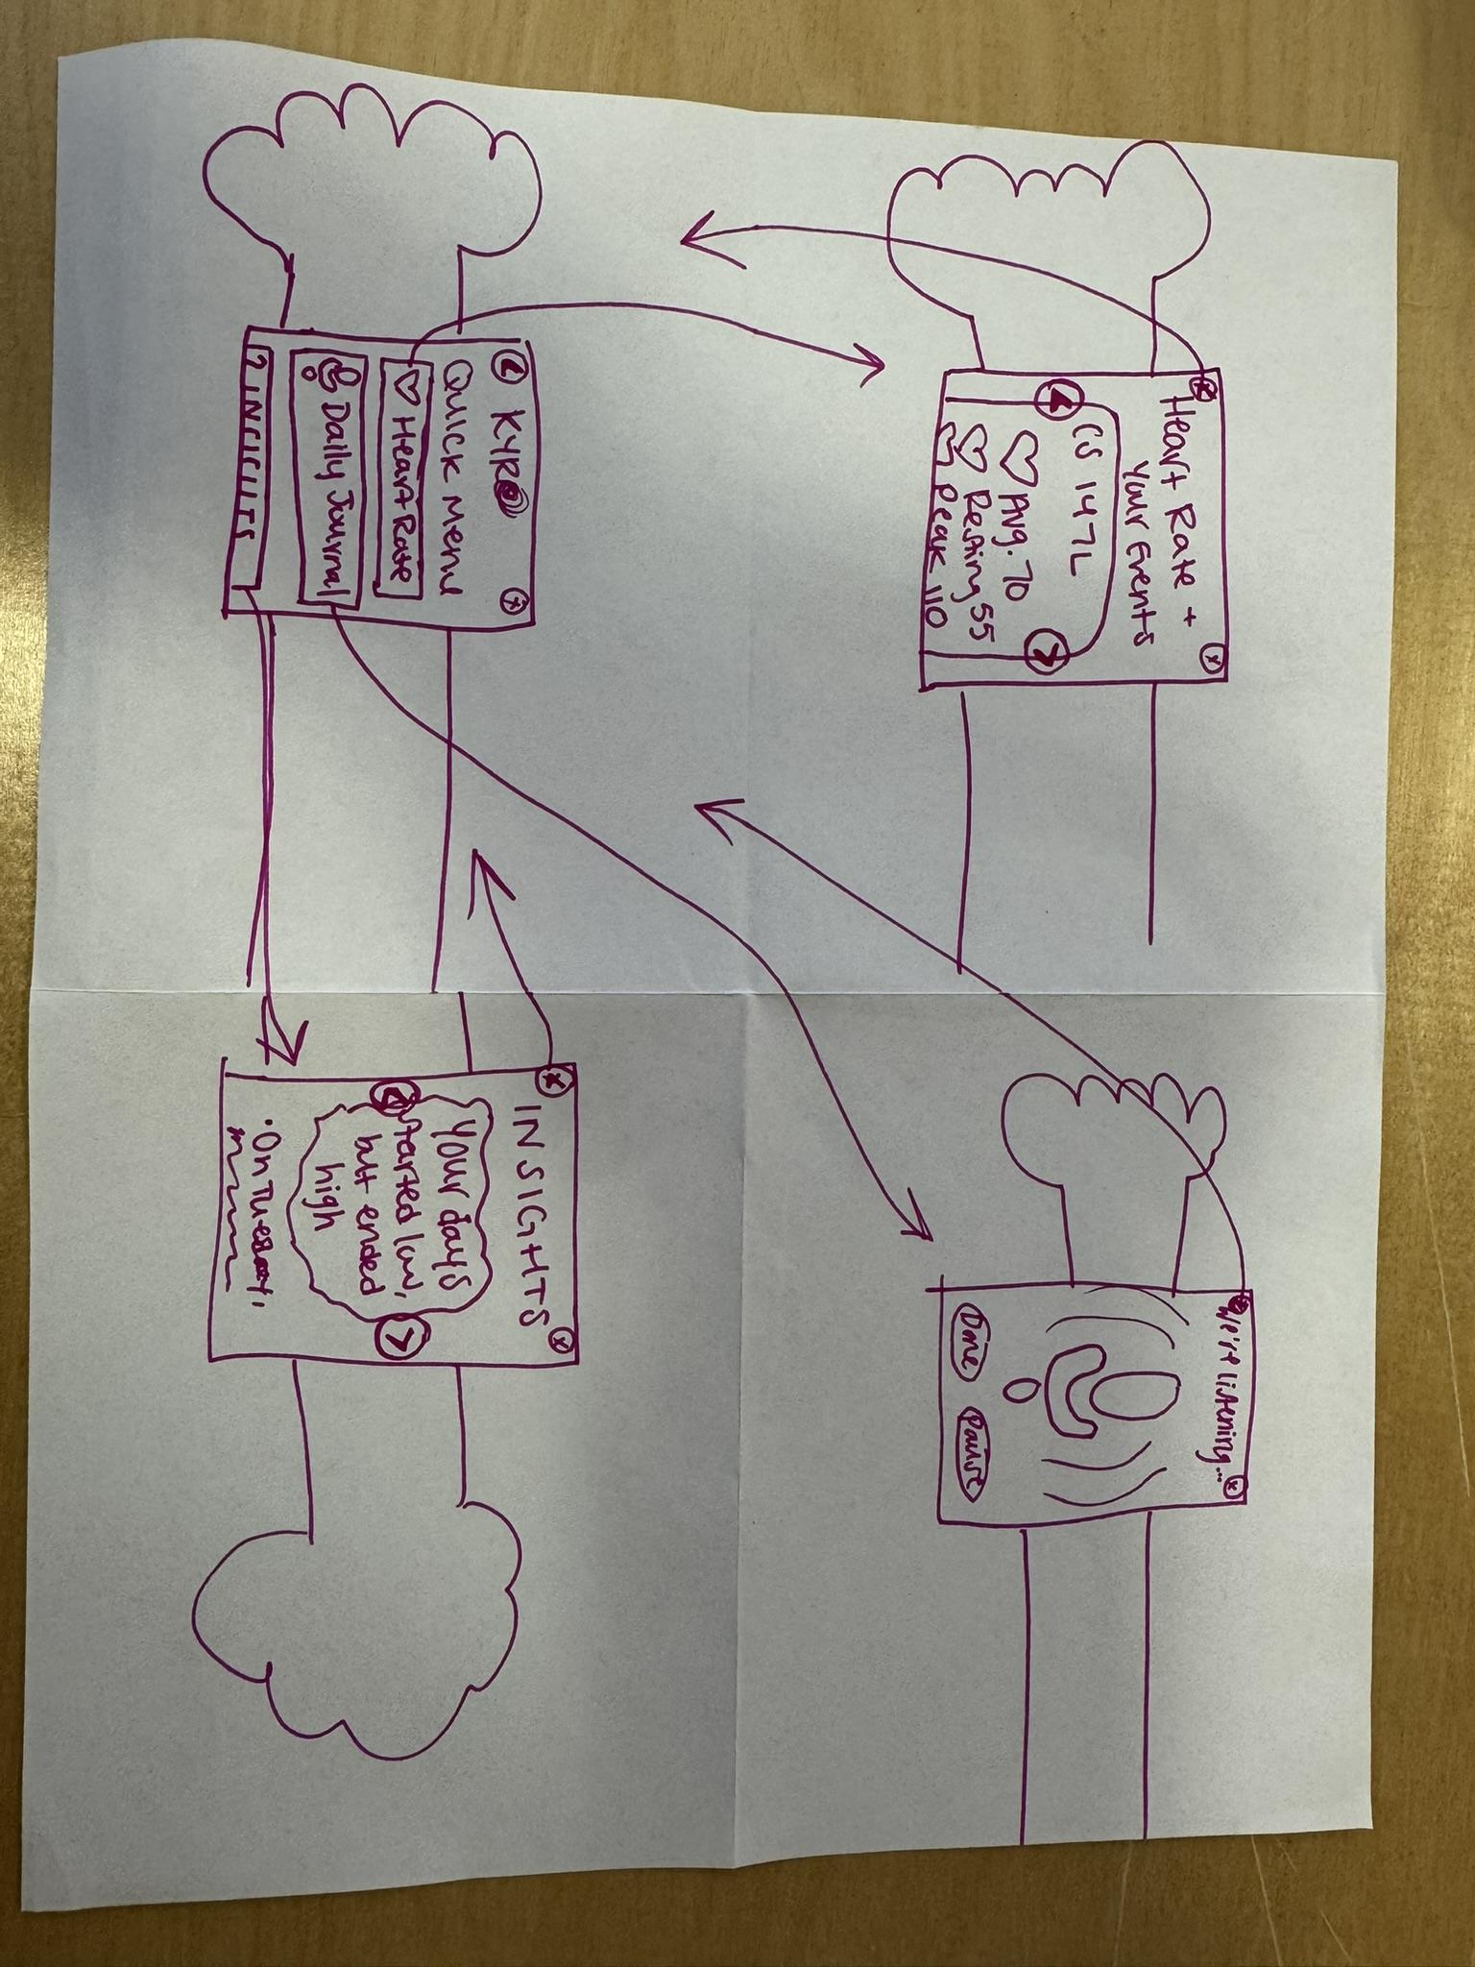
SMARTWATCH

Slide 14
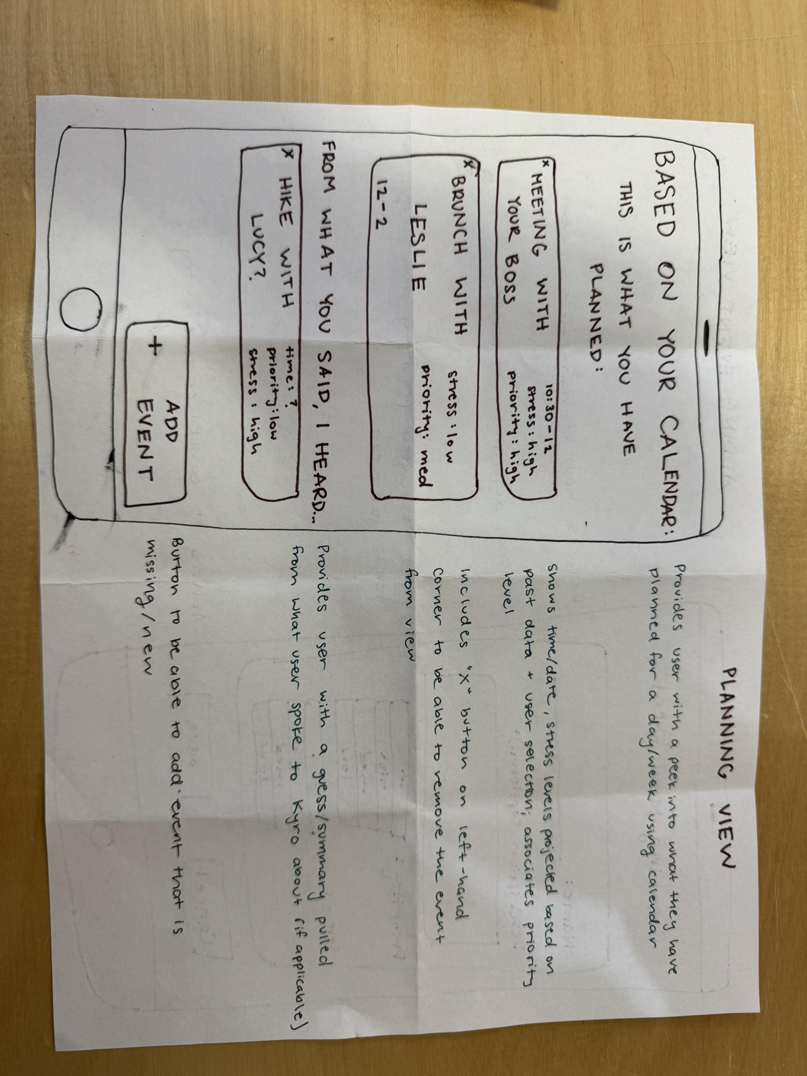
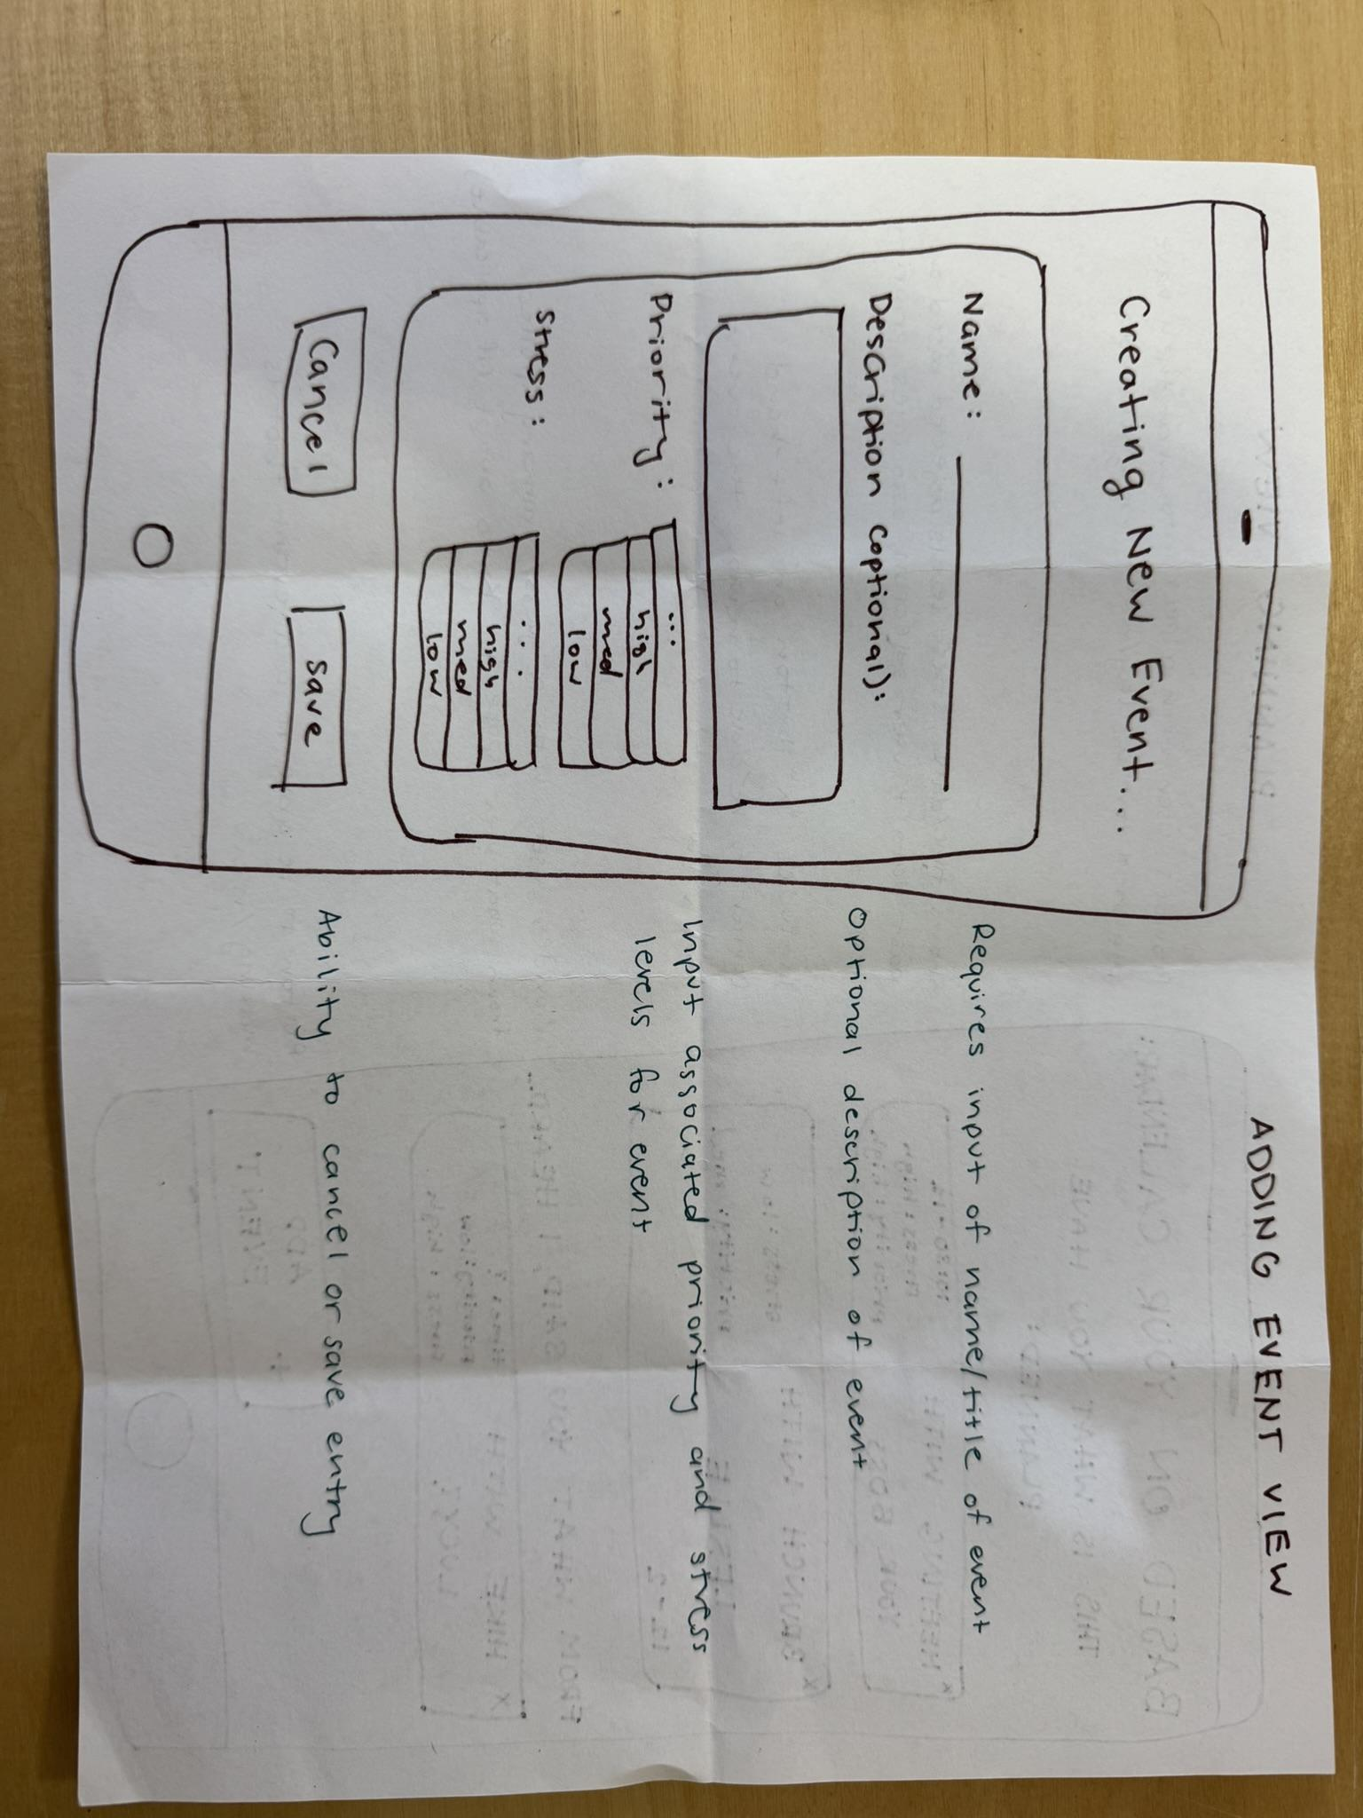
MOBILE

Slide 15
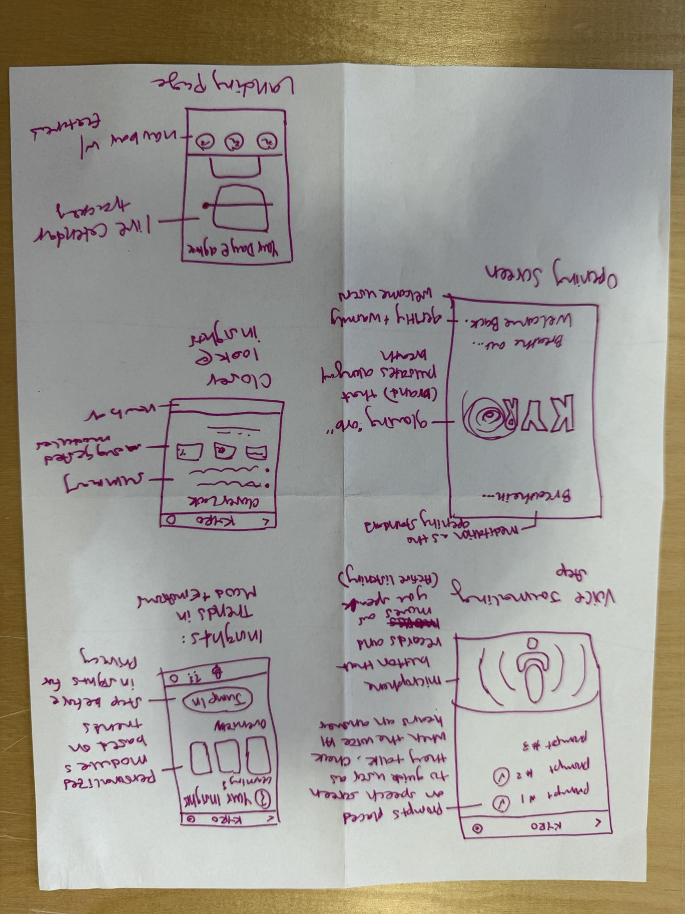
MOBILE

Slide 16
MOBILE
Our Chosen Interface
Exploring why mobile fits best

Slide 17

Our Chosen Interface: Mobile
PROS
CONS
Harder to use during physical activity
Possibility for distraction
Widget capabilities
High pairing ability
Extensive scheduling capabilities
Difficult to use discreetly

Slide 18

Relevant Data, Constraints, Findings
Our Findings
Constraints
>70 % of wellbeing-tracking users engage primarily through mobile devices rather than desktop
Mobile users check their phones 80+ times a day
Existing apps like Headspace and Streaks show higher retention when tasks are tied to daily routines and widgets rather than stand-alone reminders
Requires minimalistic dashboards as opposed to desktop interfaces
Apple HealthKit and Google Fit require explicit user consent and on-device storage for sensitive biometric data so all emotional labels opt-in

Slide 19

Why Mobile is The Best for Kyro
Mobile first for emotional authenticity: Users are most honest in personal contexts — phones enable private, real-time logging immediately after events
Calendar integration works most naturally on mobile: syncing with users’ calendars (Google, iCal, Outlook) is important for Kyro and seamless on mobile. It enables real-time adjustments and reminders
Widget Capability is a major advantage: lets users check in or view insights from their home screen while reducing distractions and app switching

Slide 20
Low-fi Prototype
We created a paper prototype representing key user flows across multiple screens — including adding events, logging reflections, and importing the calendar.
The prototype was designed to be minimalistic, accessible, and compassionate, using simple layouts and clear visual cues to reduce cognitive load.
Users can move through the flow by “tapping” or “swiping” on paper screens to simulate interactions, allowing us to test usability and emotional tone before building a digital version.
We also simulated allowing personalized views by having the computer provide an “AI summary” in real time

Slide 21
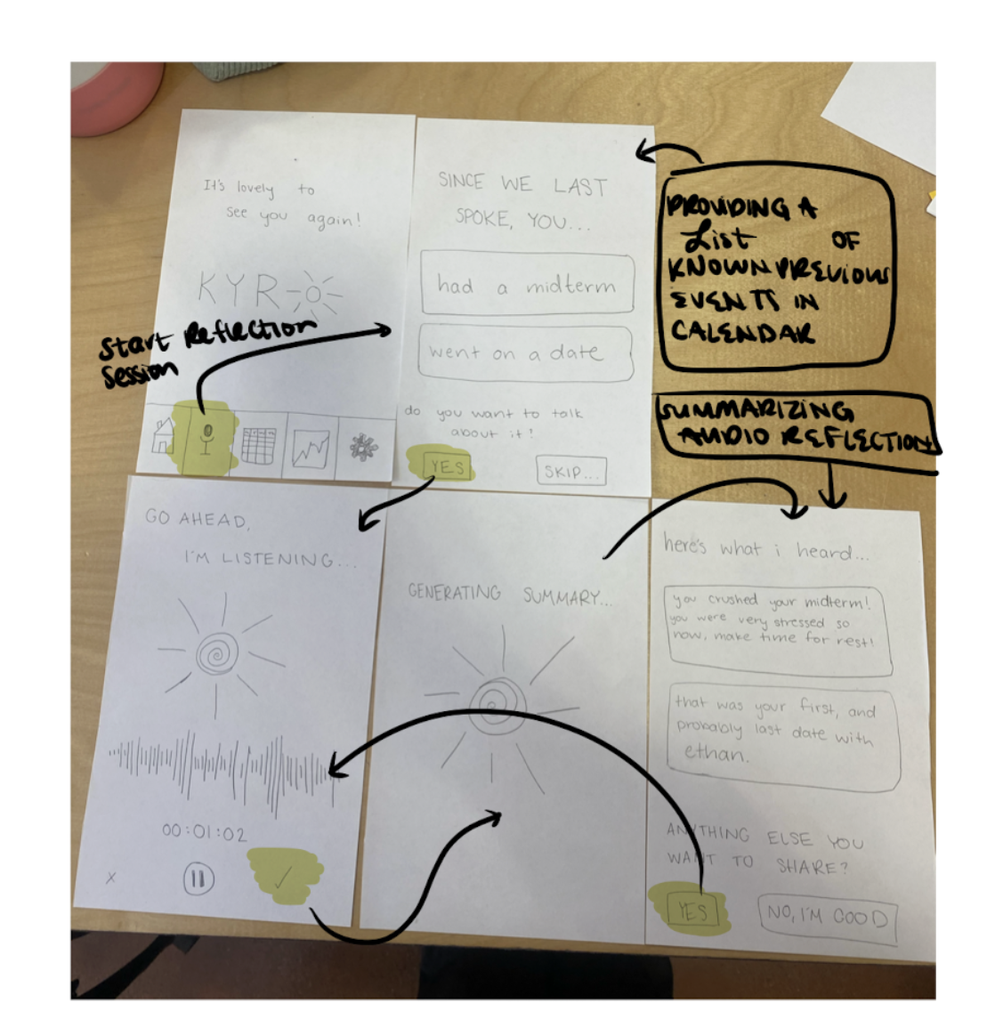
Reflect On Your Day
Initial Landing Page w/ Navigation Bar
Initial reflection landing page
Recording Page
Reflection summarized back to user
Summary Generating

Slide 22
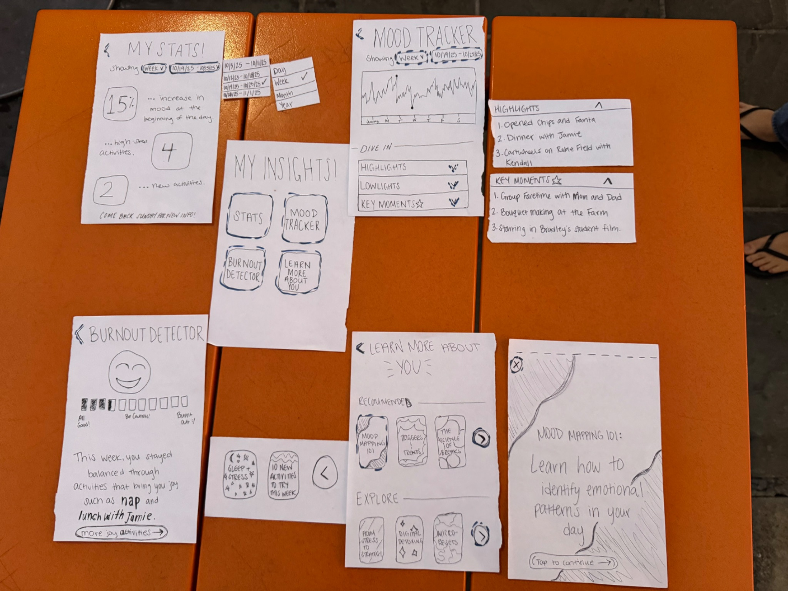
Specific Recommended Emotion Modulec
Stats: Condensed page with key statistics relating to the user’s activities and logs
Mood Tracker: User can look at mood/valence tracked over different intervals of time and revisit big moments from the past
Example dropdowns: User gets a feel for what these features might entail
Insights Landing Page: Navigate to different analytics from this page
Specific Recommended Emotion Modulec
Burnout Detector: Kyro will tell users how close they might be to burning out based on their past logs and schedule
Learning Landing: User can explore learning modules curated to teach them something relevant about wellbeing
Example learning module: User has the chance to quickly and easily explore a topic related to wellbeing that is recommended to them based on their logs

Slide 23
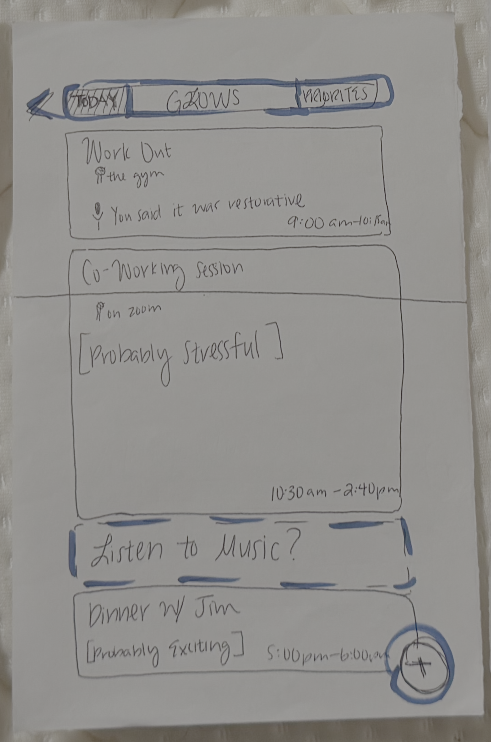
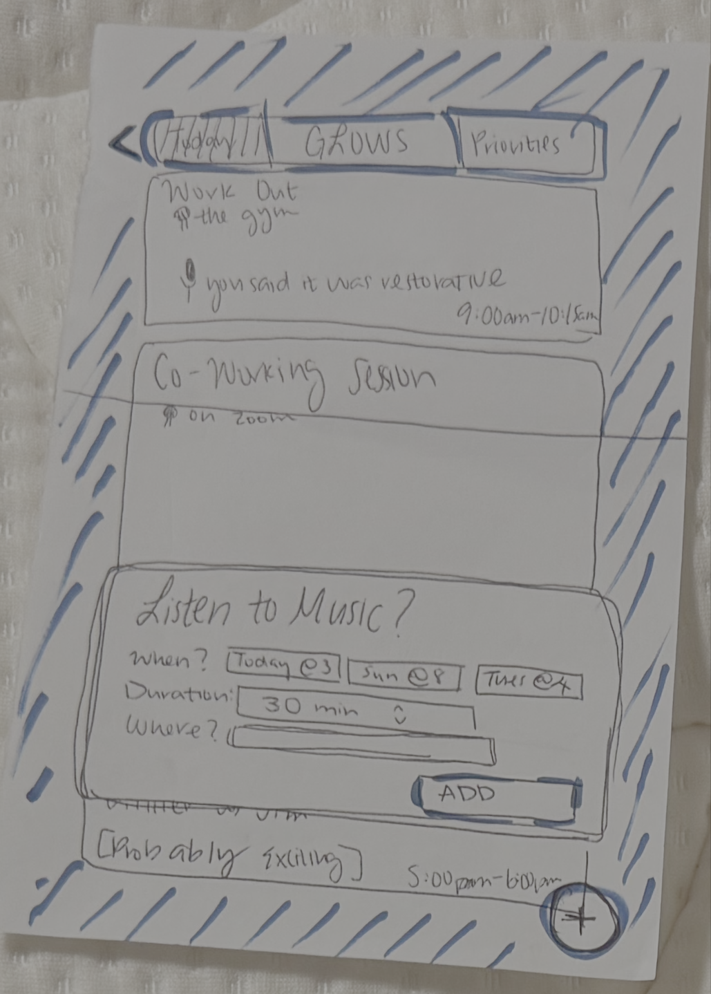
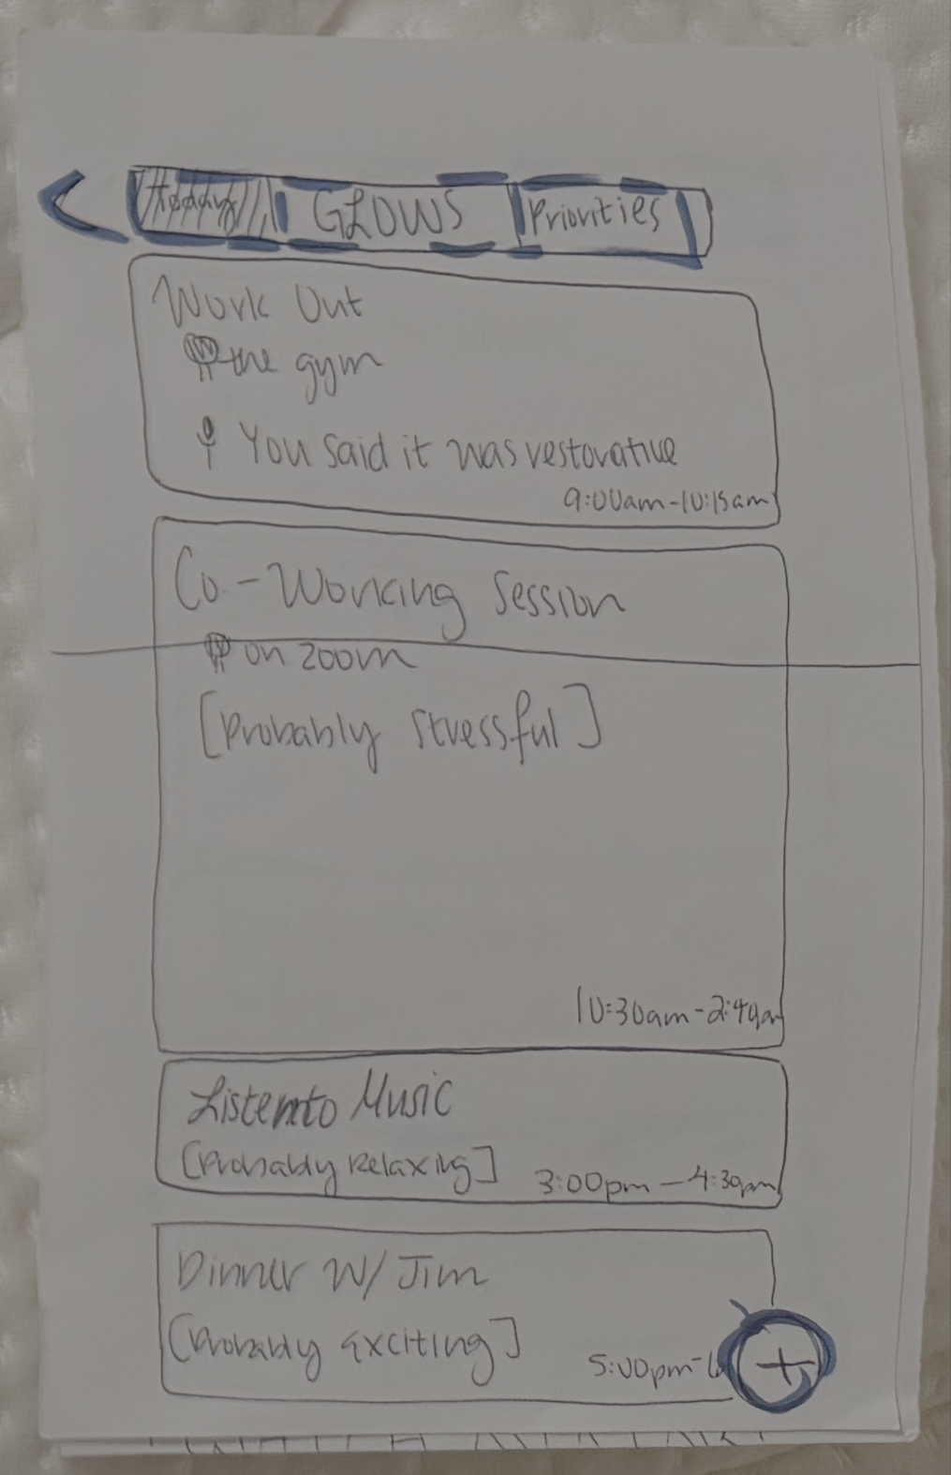
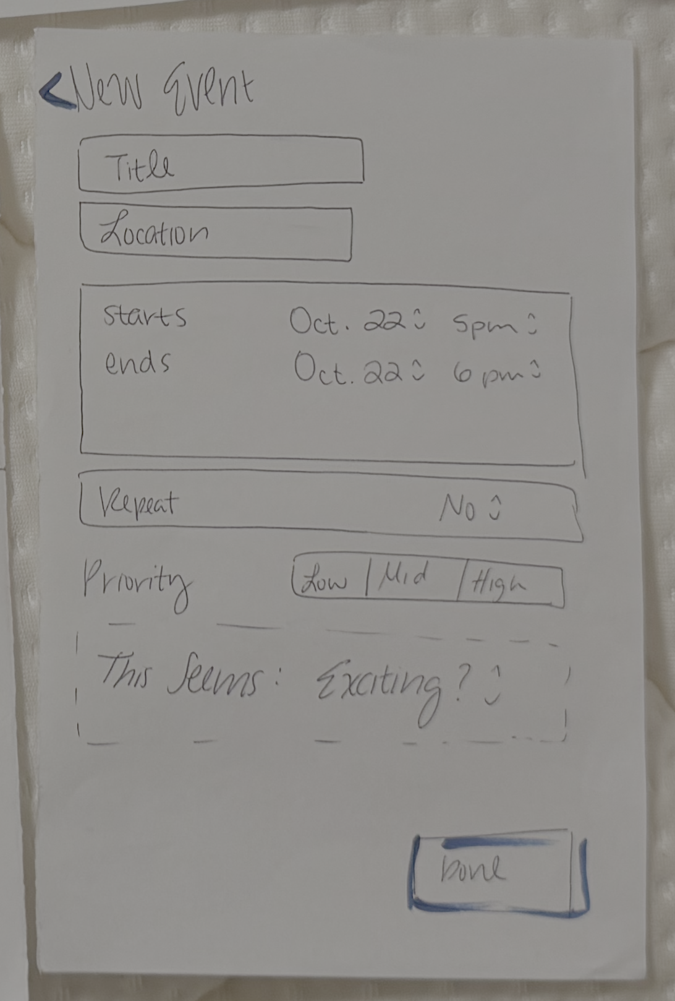
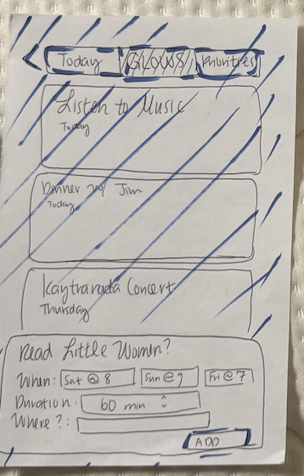
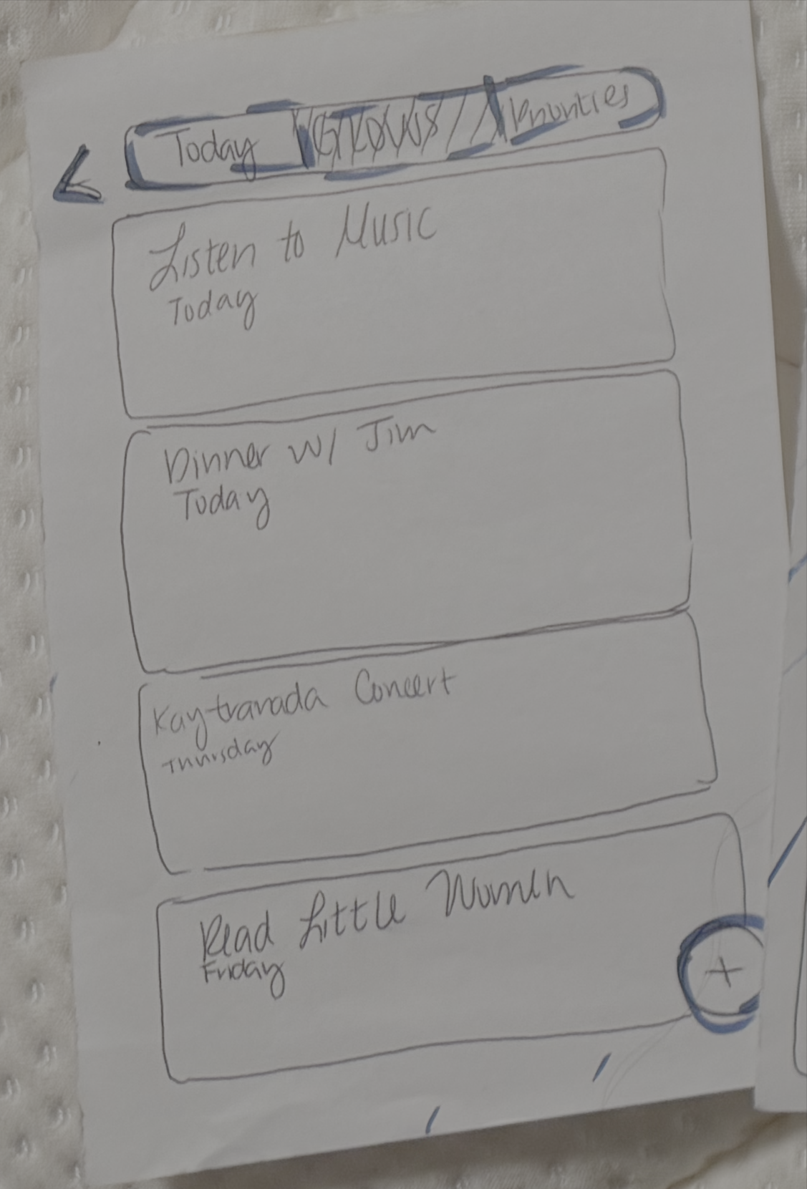
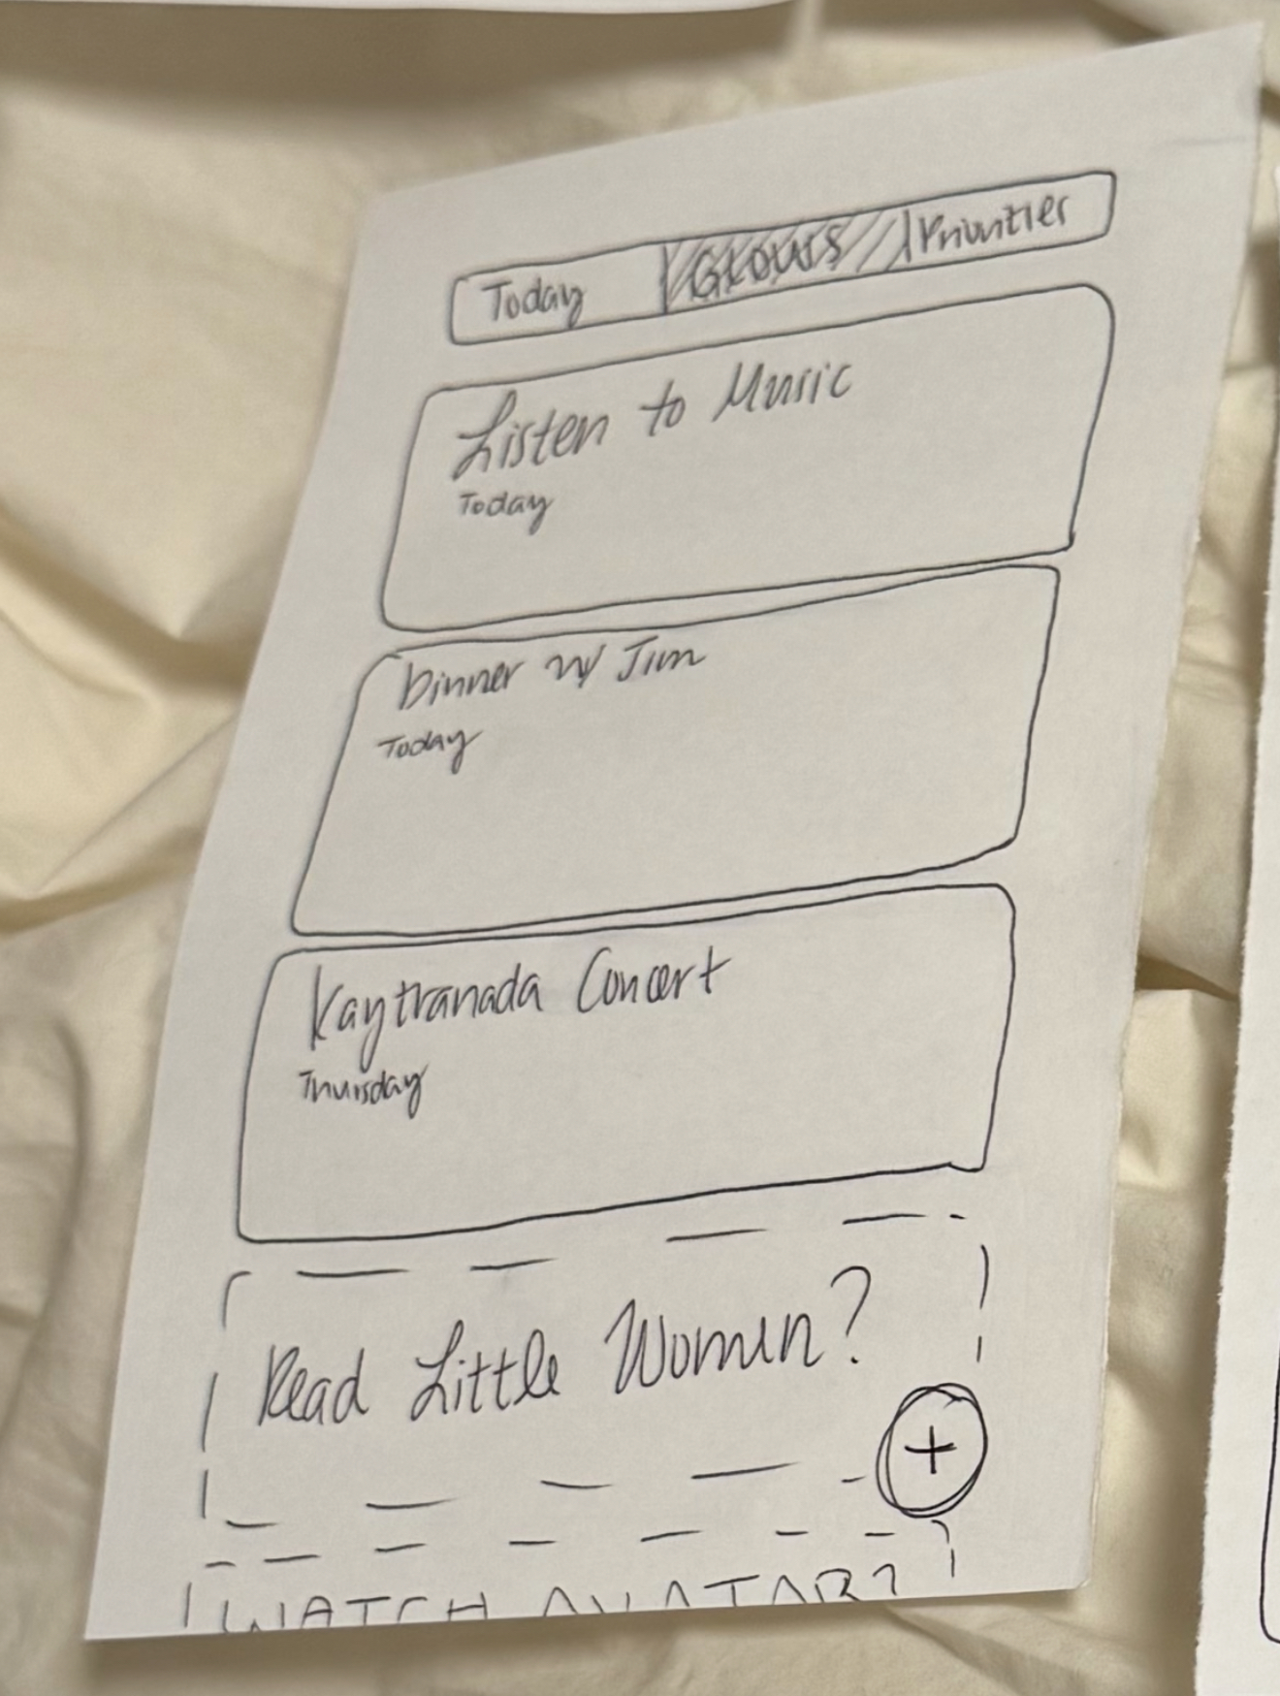

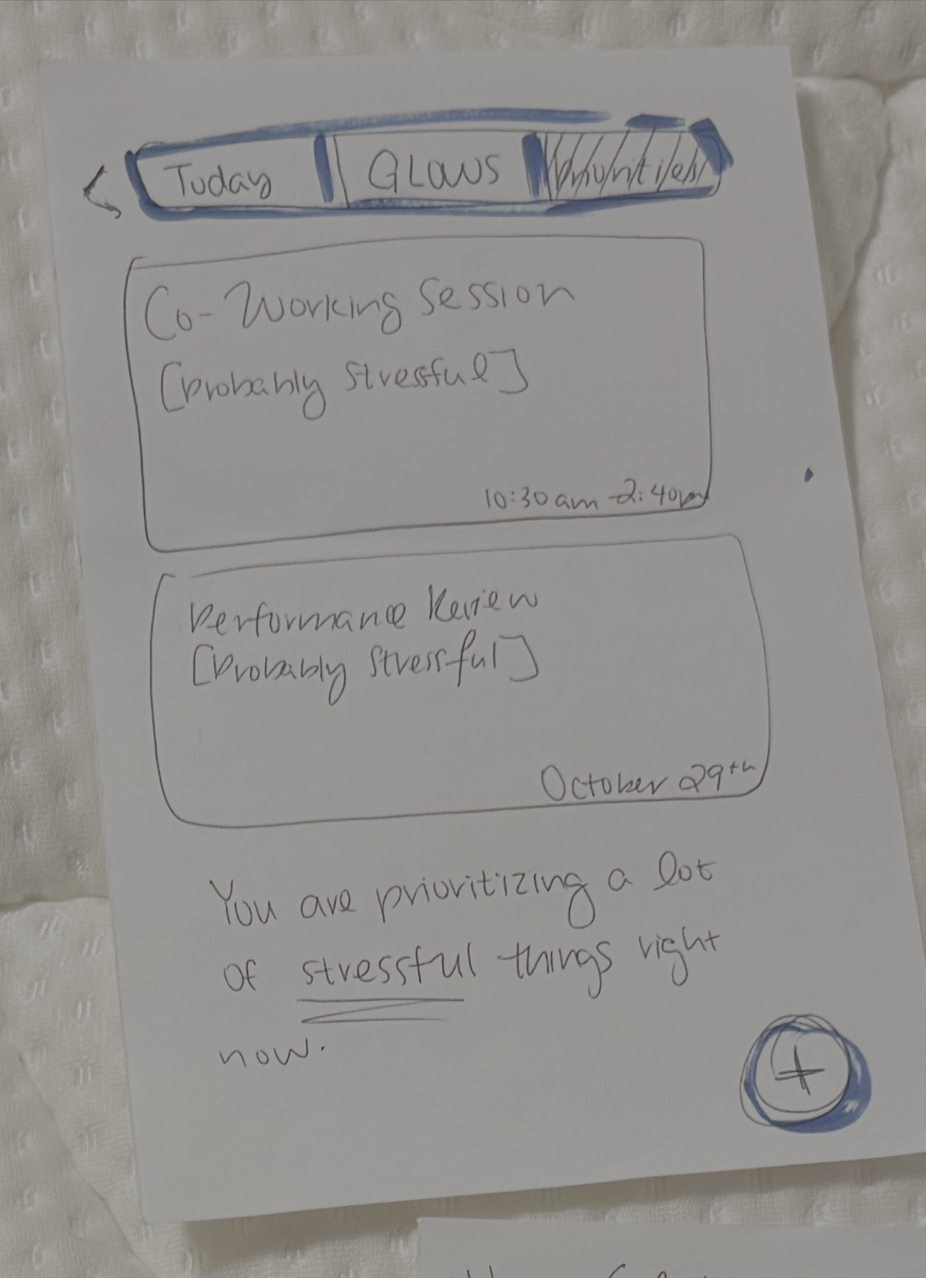
Plan your schedule w/ Emotional Guidance
Display today’s events, suggestions, and emotional predictions
Quick add suggested event
Suggested event added
Alternate views to analyze your calendar with different perspectives
Add unsuggested event

Slide 24
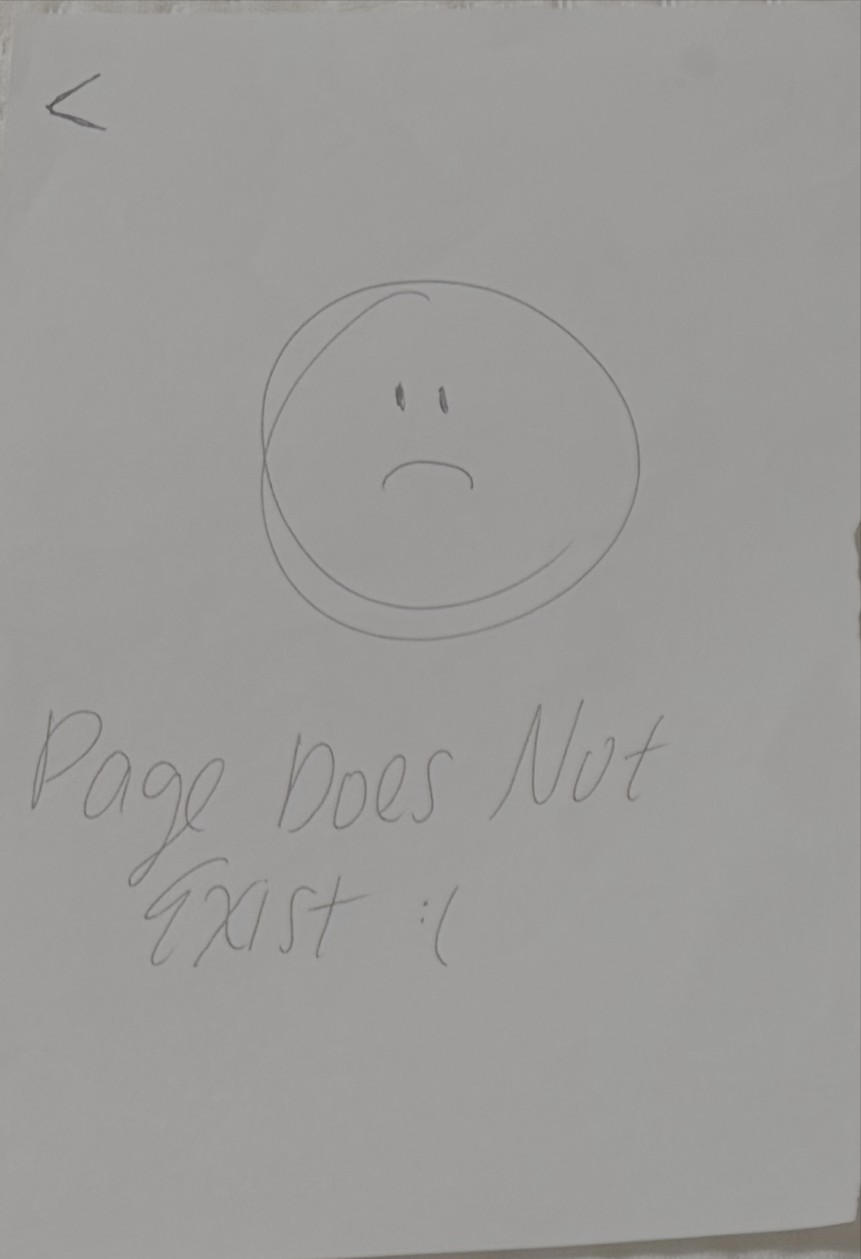
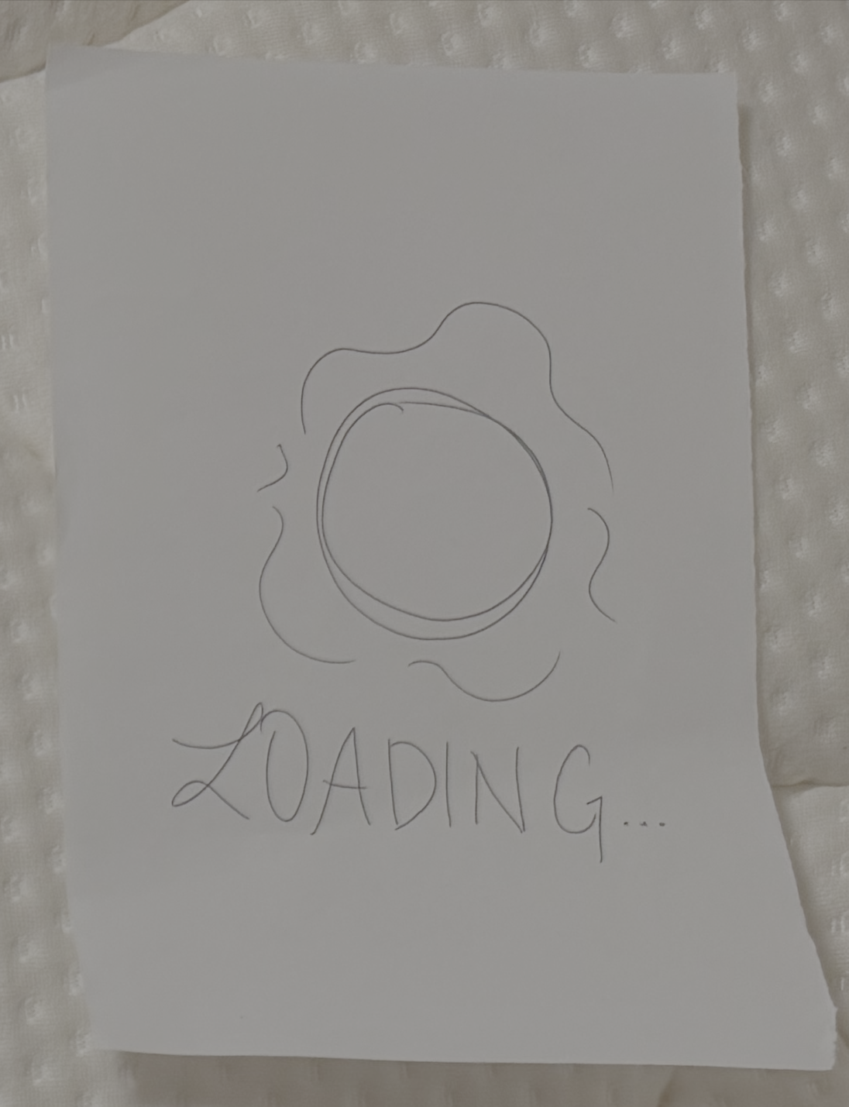
Page Does Not Exist
Loading

Slide 25
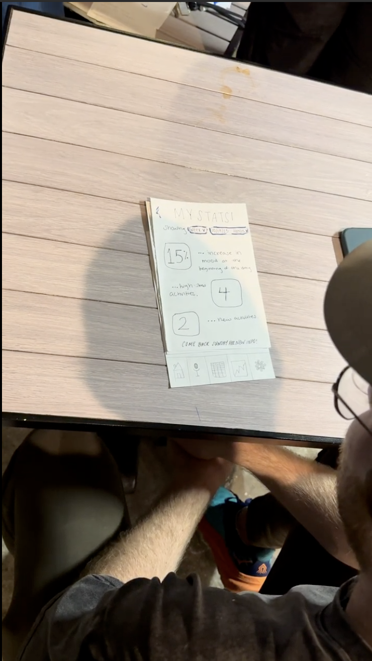
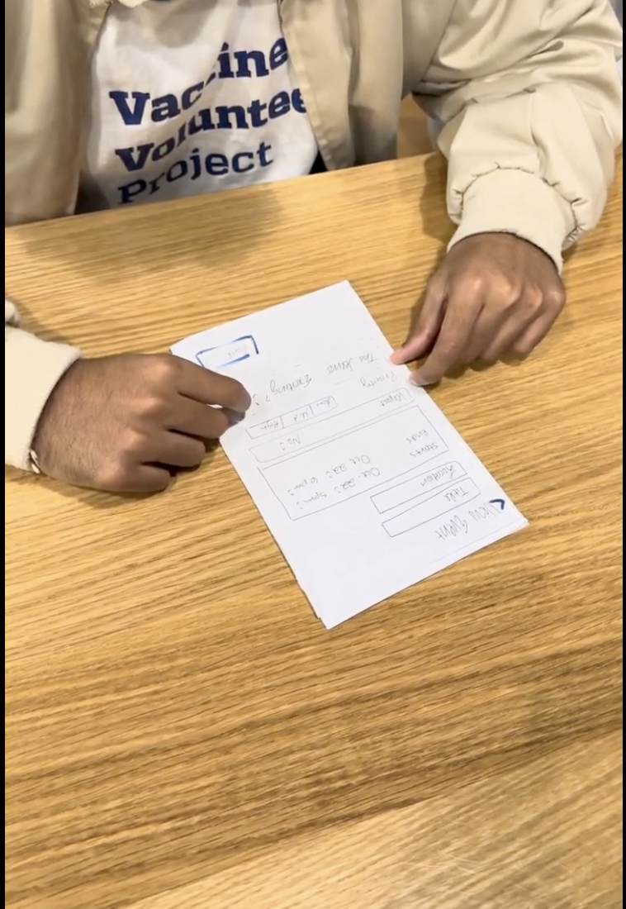
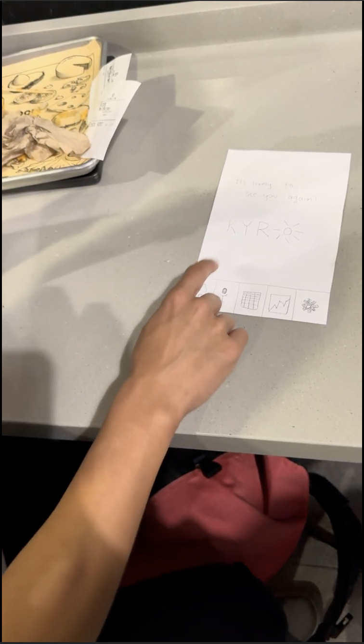
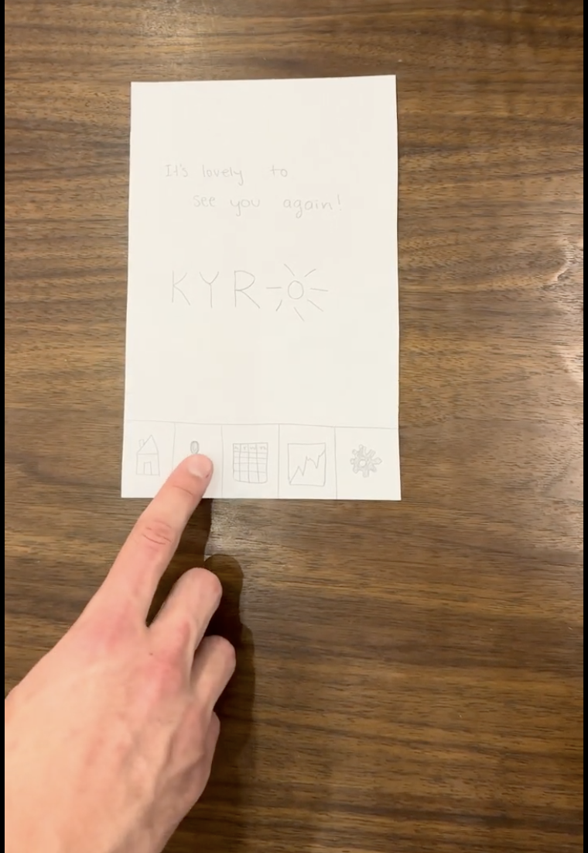
PARTICIPANTS
A
B
Participants fell within our intended user base of working young adults (18-44, highest users of virtual calendars)
Four participants found in various parts of Palo Alto:
A: CEO and Founder of an AI startup (mid-20s)
B: New grad working in tech (early 20s).
C: Design developer at another AI startup (late 30s)
D: Senior from a high school in Sunnyvale working in food service (18)
📍 Teaspoon
📍 The Melt
C
D
📍 The Melt
📍 on shift @ Antoine’s Cookies

Slide 26
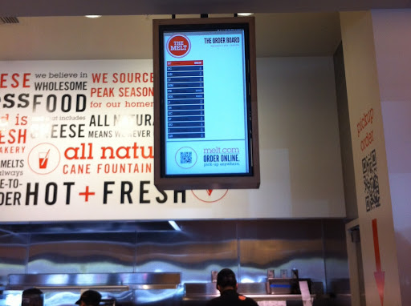
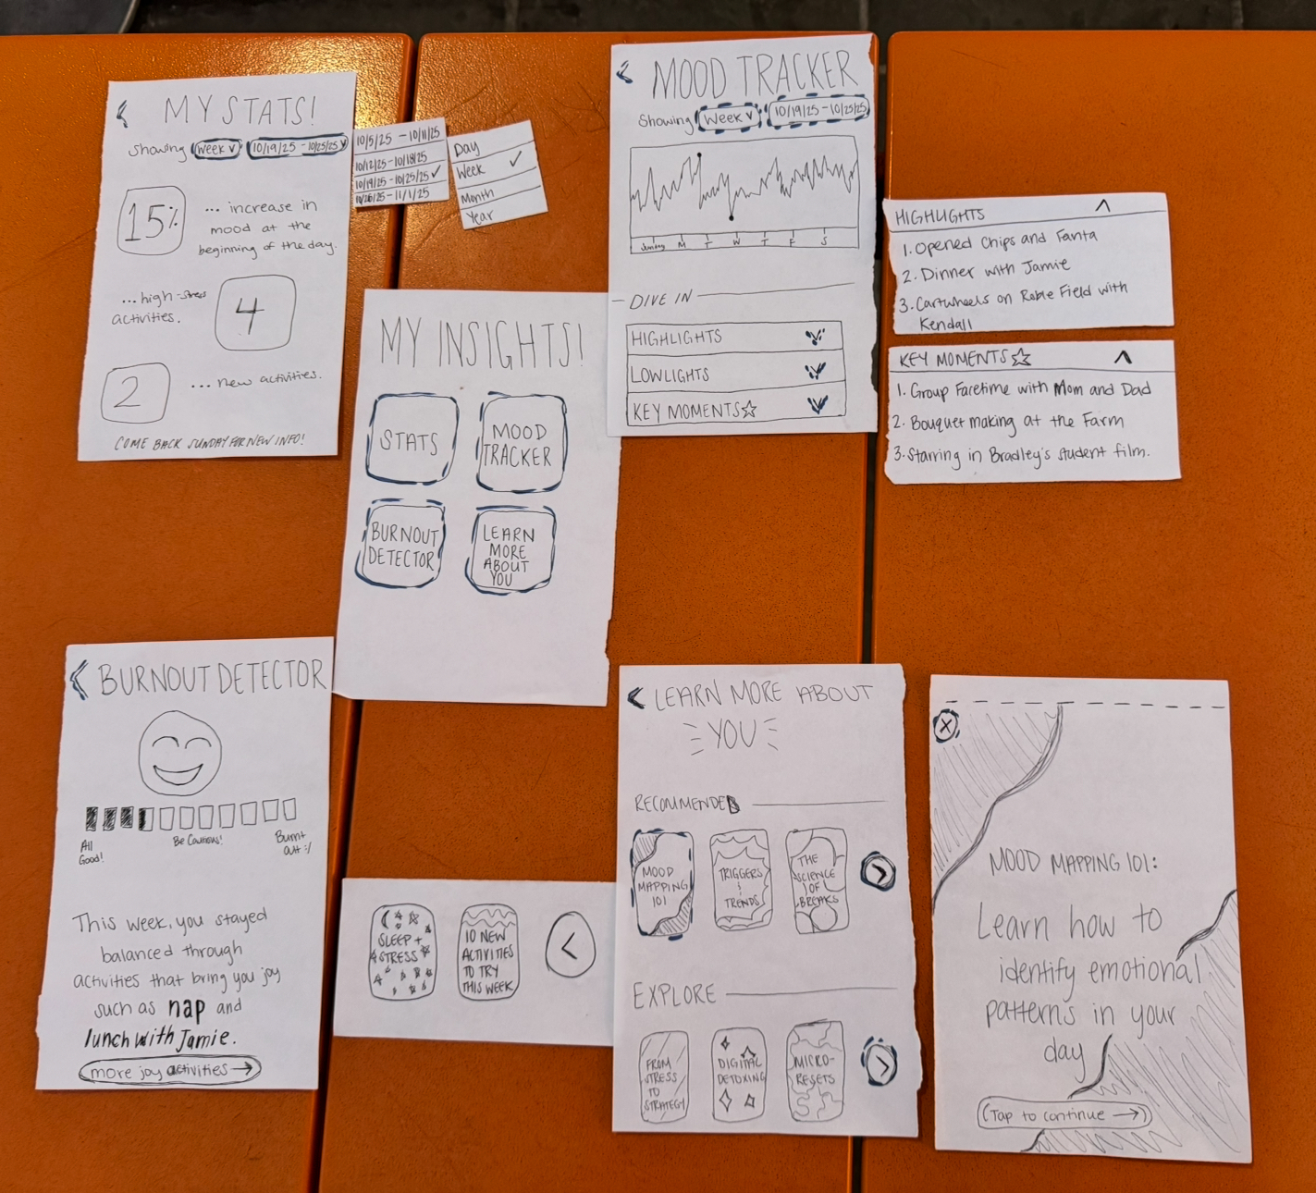
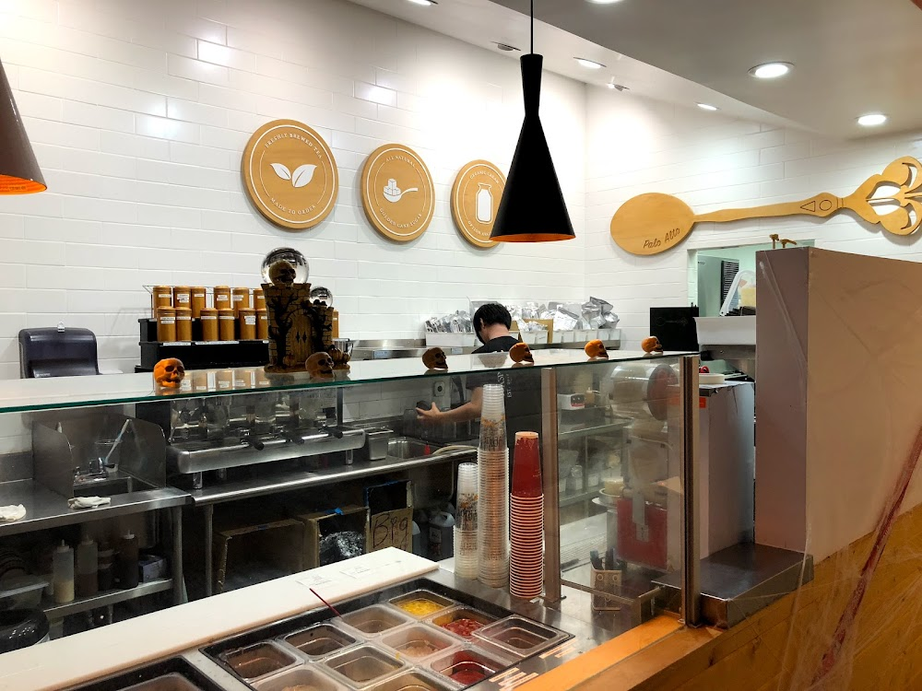
ENVIRONMENT
Met users where they were to reflect ideal use environment (wherever user feels comfortable)
Placed prototype on the surface in front of them (table, counter)
PROCEDURE
Gave users brief context on Kyro (values, summary, possible uses)
Provided a demonstration of how to use the prototype
Instructed them to Think Aloud, explaining what was intuitive, what caught their eye, and what came to mind
Gave them three end goals, only intervention was “Page Does Not Exist” screen
Example task flow laid out on separate table for computers to grab (away from user)
ROLES
Amesha: Facilitator | Bennie + Gabriella: Computer | Gil: Notetaker

Slide 27
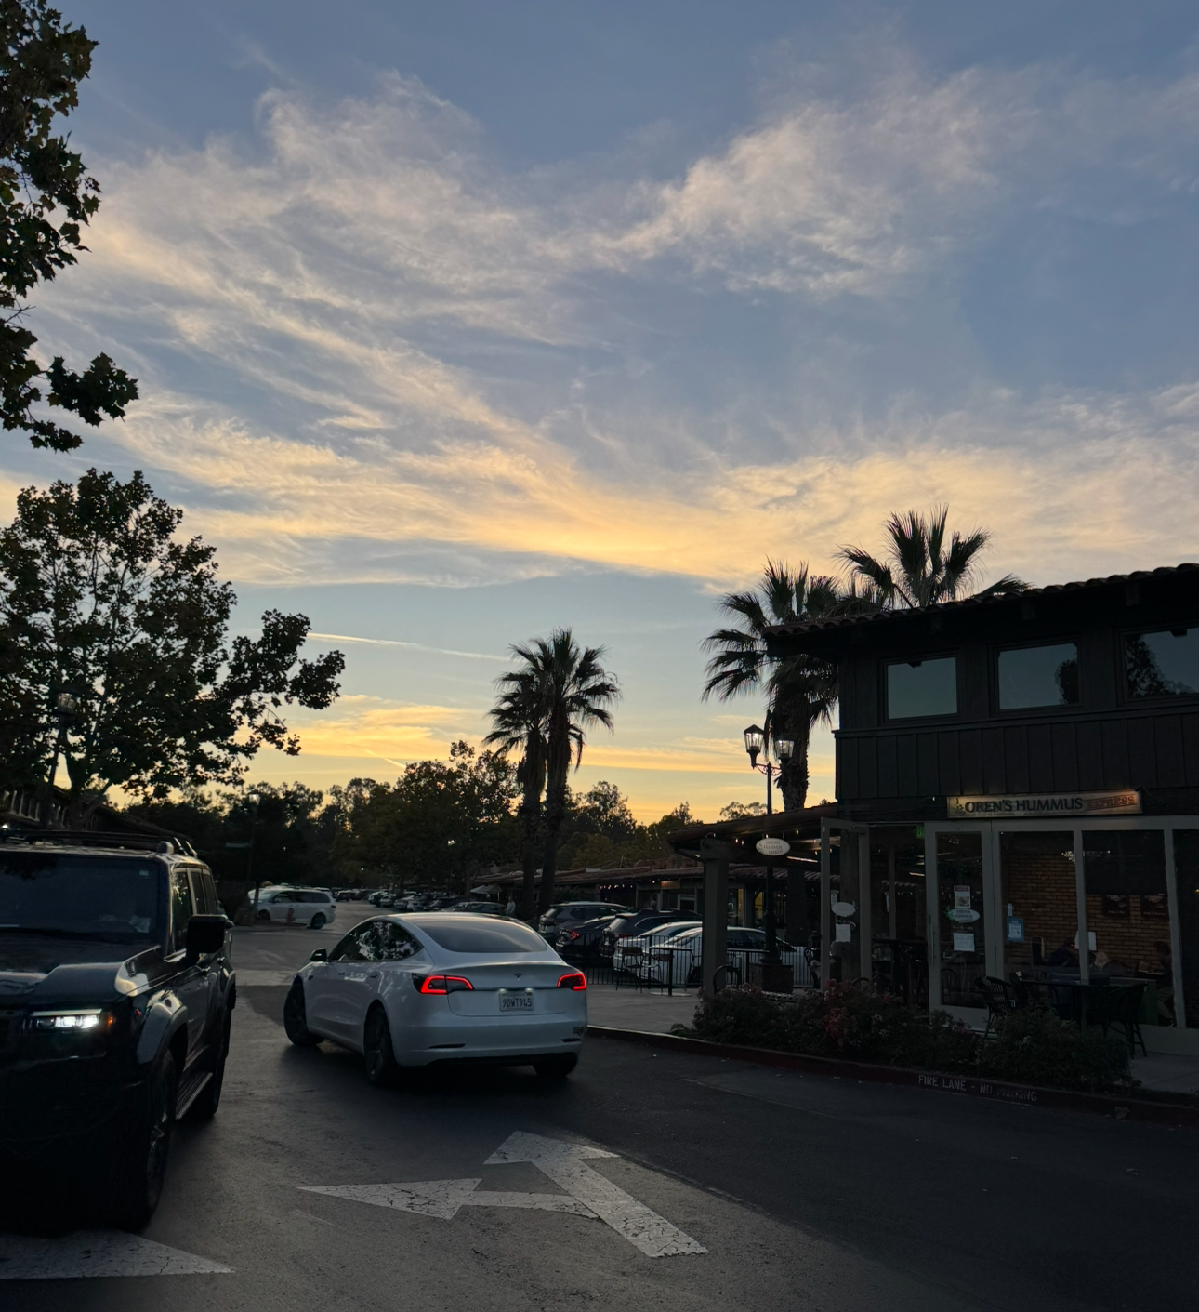
USABILITY GOALS
Efficient:
User is able to complete tasks quickly with low friction.
Pleasing:
User feels a deep sense of satisfaction after completing one or more tasks with Kyro, especially since every task is meant to be mentally enriching and clarifying for users.
Interesting:
User feel captivated by the content they receive and compelled to explore as much of Kyro as they can, coming back week after week when new information is created.
KEY MEASUREMENTS
Time to complete task (efficient)
Number of actions taken to complete task (efficient)
Number of non-existent pages clicked on (interesting)
User satisfaction (pleasing)

Slide 28
RESULTS - CRITICAL INCIDENTS
# | Description | Severity (0–4) | Evidence / Quote | Design Implication
1 | Users confused about time context (“Is this today or next week?”) | 3 – Major usability problem | Multiple users asked this verbally | Add clear “Today / Upcoming” banner + color-coded section
2 | What the “Insights” icons was was unclear | 2 – Minor usability problem | “I clicked until I figured out what they meant” | Add text labels + onboarding overlay
3 | How to speak was unintuitive; users consistently clicked on event to record (stale page) | 2 – Minor usability problem | “I wasn’t sure if it was still recording” | Add animated mic + color feedback
4 | Home page served no apparent purpose | 2 – Minor usability problem | “Home page is obsolete, nothing to do besides the navbar.” | Potentially combine analytics into one scrollable page

Slide 29
RESULTS
Main Issues Identified
Confusion around time context (today vs next week)
Unclear icon meanings and limited home-page context
Ambiguity in voice-recording feedback procedure
Analytics scattered and hard to interpret
Potential UI Changes
Onboarding overlay: add an intro explaining “Log / Plan / Reflect.”
Context banner: persistent “Today / This Week” label above schedule view.
Animated mic + color feedback: indicate when recording starts/stops.
Single scrollable analytics page: simplified, labeled metrics (e.g., stress %, energy level).
Predictive cues: gentle prompts (“Schedule rest?” / “Too many stress events?”).
Our key measurements showed that our efficiency and interest goals were met; users were able to complete tasks quickly,and all user tests took less than 5 minutes to complete 3 tasks holistically. Additionally, when given the chance to explore, users approached the app with curiosity and clicked on dropdowns/scroll options just to see what else was there.
In debriefing,users felt happy with the concept and thought the effort was notable and the idea was tangible; it was easy to see what the goals were, and they were excited by the concept.
In next steps, based on what we saw, priorities would include integrating one of our tasks into the home page to give it purpose, making a clearer insights tab icon, adjusting the recording layout for events vs microphone, and making the calendar more central to the app rather than just a feature.

Slide 30
APPENDIX
Notes:
Appendix: Present the most relevant pros and cons and have the full lists in the appendix

Slide 31
Our Chosen Interface: Mobile
PROS
CONS
High task flow due to full gestures
High pairing ability with [other] devices
End-to-end scheduling
Potential widget integrations
Intuitive UX for calendars
Reduced friction because people are already used to calendars and recording messages on phones
Screen time fatigue/lots of distractions
Saturated modality for wellness apps/no competitive advantage
Harder to use during physical activity
Hard to use discreetly
Data privacy and selection of data access
Harder to use during physical activity
Notes:
Appendix: Present the most relevant pros and cons and have the full lists in the appendix

Slide 32
PROCEDURE (cont.) - for appendix
Show how prototype works
“Pretend this is an app.”
Explain tapping and scrolling will mimic an app
Everything on our screens highlighted in blue was clickable/had another screen, DID NOT tell them this was the case to see if the highlight was intuitive
Explain that if they clicked on something without a follow-up screen, they would see “Page Does Not Exist”
Tell them they’ll be asked to complete three tasks within the app
As they complete them, they should tell us what they’re seeing, thinking, and wondering at all times (Think Aloud Method)
As they click, the app will respond, so be cautious!
Explore whatever might feel interesting or relevant to your task.
Navigate to the home page once you’re done.
If they get stuck, we encourage them to think about how they would troubleshoot (non-intervention unless screen doesn’t exist)
Tell them their tasks (next task given after previous was completed
Task 1: Tell Kyro about your day
Task 2: Add an event to your calendar based on your mood patterns from Kyro.
Task 3: Gain a better, well-rounded understanding of your emotional patterns collected.
Debrief
What did you take away from this experience?
How easy or difficult was it for you to perform the tasks given?
What, to you, is the purpose of Kyro now that you’ve interacted with it?
What is important for us to prioritize in our next stage?
Anything else?

Slide 33
Script
Facilitator:
“Hi! Thanks for helping us test our paper prototype today. Our app is called Kyro, and it’s an emotional scheduling app that helps people plan their time based on how they actually feel, not just what’s on their calendar. We’ll test 3 features today and just a reminder: this isn’t a test of you — it’s a test of the design, so feel free to think out loud as you go. We’ll ask for feedback at the end as well. How does that sound?
“Okay, let’s start with reflecting on your day using our voice feature. On this paper version, show me how you’d do that.”
“Now, imagine you’re planning your week and want to add a study session for tomorrow evening. On this paper version, show me how you’d do that.”
“Great! Now, imagine it’s the end of your week and you want to see how you’ve been feeling overall. Show me where you’d go to view your emotional trends or analytics.”

